Slide 1
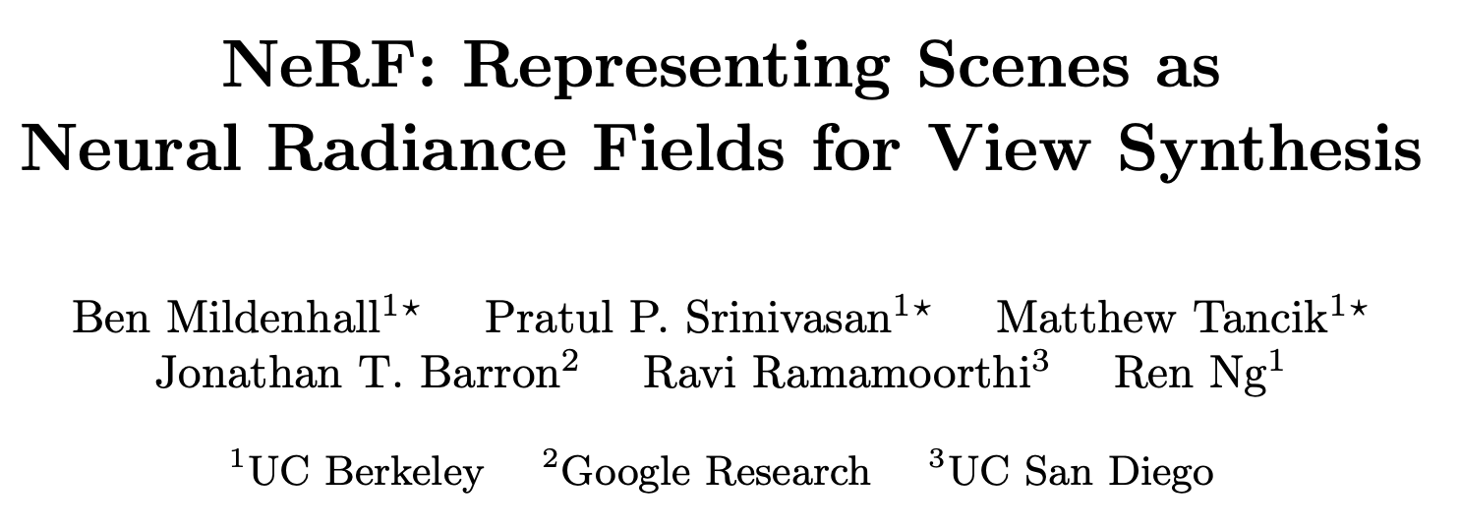
ECCV 2020
Citations: 5989

Slide 3
Neural Radiance Field Scene Representation
continuous scene → 5D vector-valued function
Input
Output

Slide 4
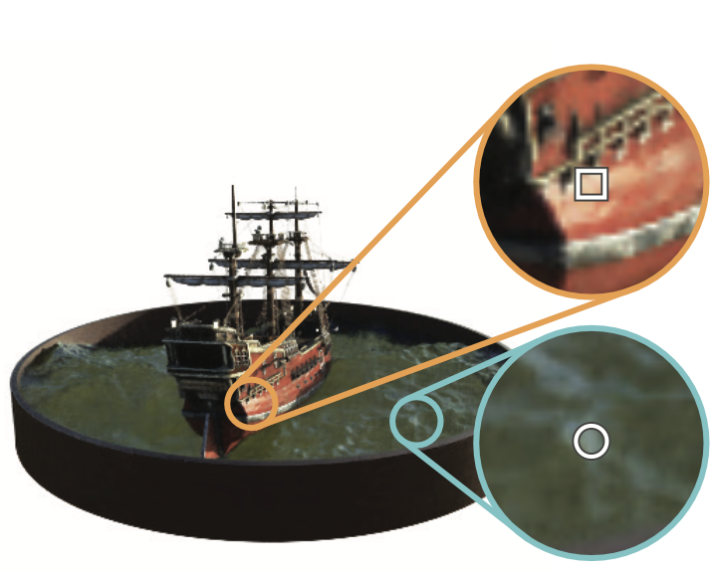
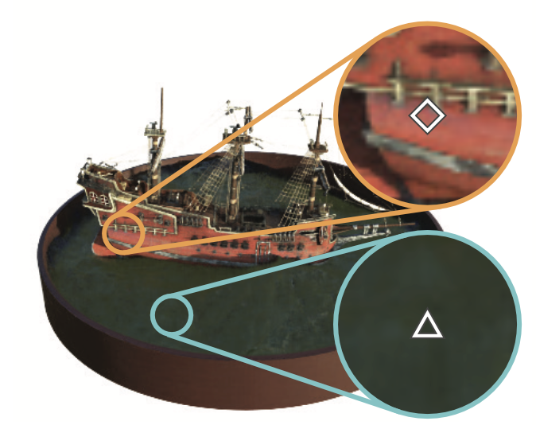
8 FCs → σ , 256-D feature vector

Slide 5
Volume Rendering with Radiance Fields
stratified sampling:
Notes:
probability that the ray travels from tn to t without hitting any other particle
draw one sample uniformly at random from within each bin:

Slide 7
Optimizing a Neural Radiance Field
Positional encoding
Notes:
two improvements to enable representing high-resolution complex scenes
Regular MLP

Slide 8
Optimizing a Neural Radiance Field
Hierarchical volume sampling
optimize two networks
coarse
fine
Notes:
inefficient: free space and occluded regions

Slide 9
Results:
Notes:
Peak signal-to-noise ratio
structural similarity index measure
Learned Perceptual Image Patch Similarity

Slide 10
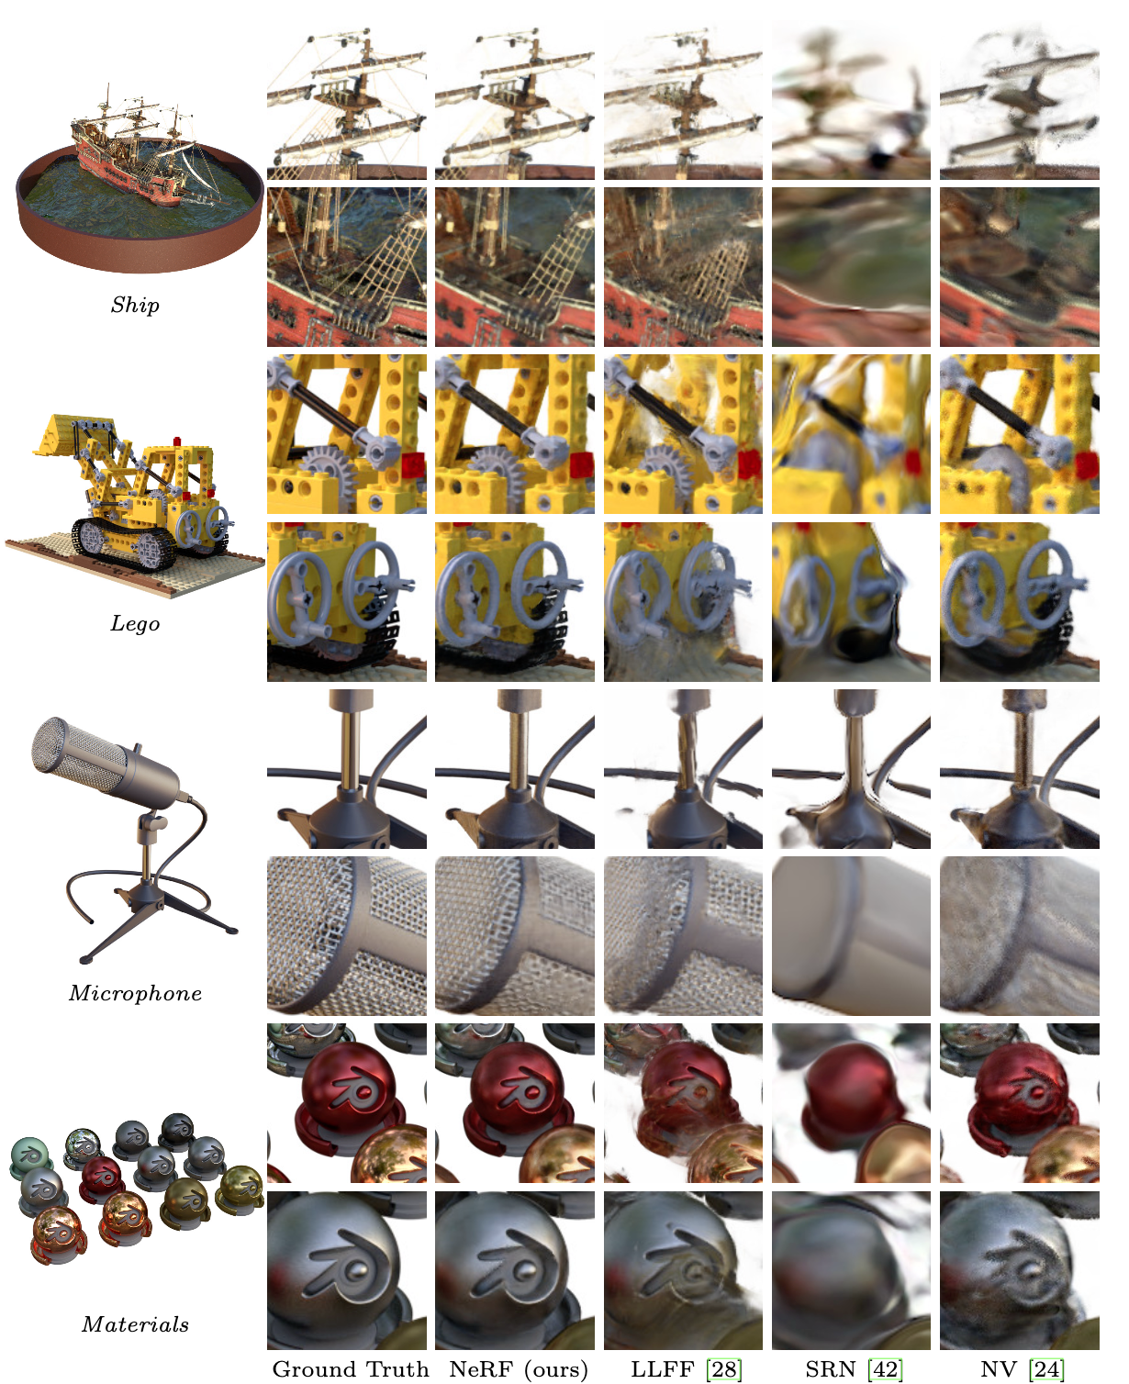
Results:

Slide 11
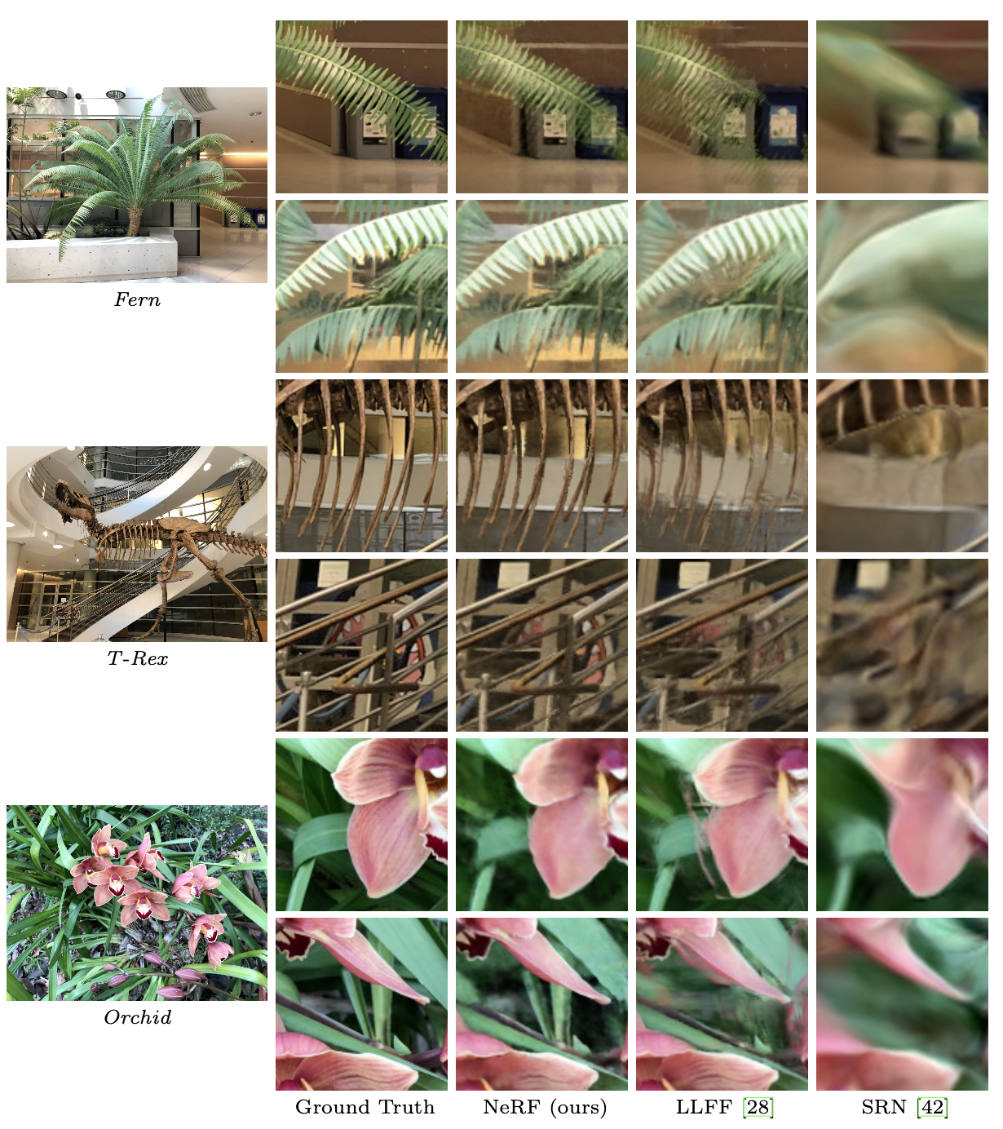
Results:

Slide 12
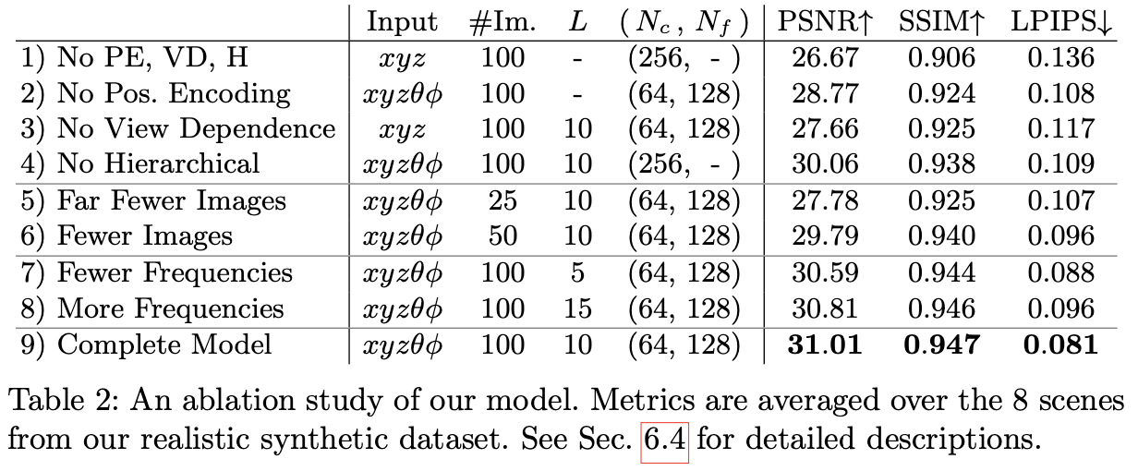
Results:

Slide 14
Q&A

