Slide 1
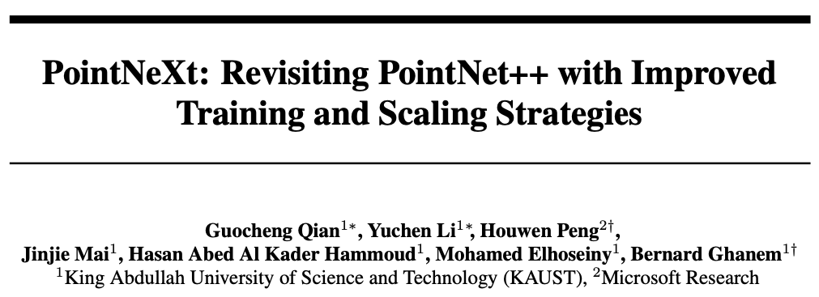
NeurIPs 2022
Citations: 281

Slide 3
Preliminary: A Review of PointNet++
input features
shared MLPs
relative coordinates
reduction layer
features of neighbor j in
the l^{th} layer of the network

Slide 4
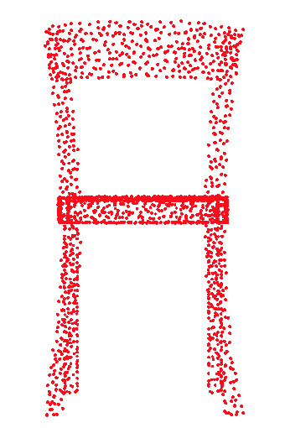
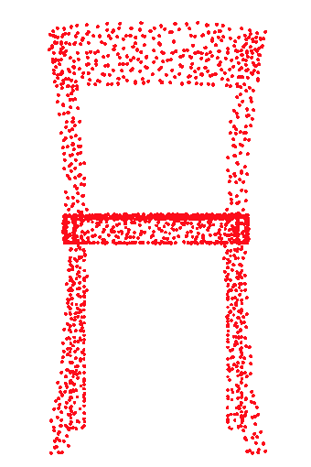
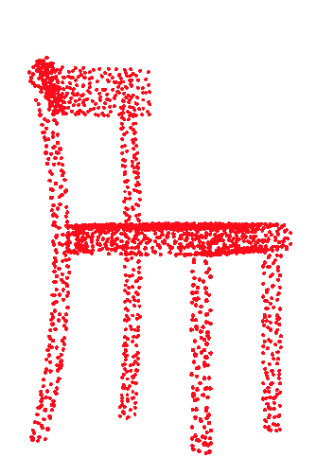
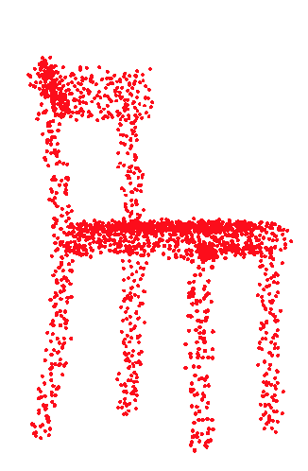
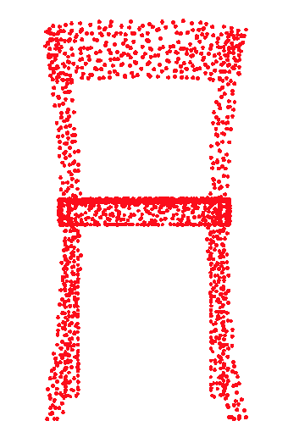
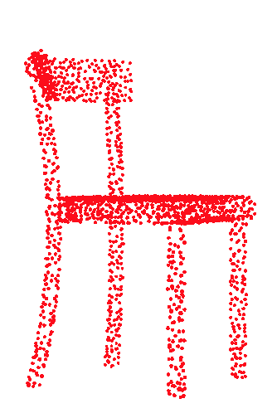
Methodology: From PointNet++ to PointNeXt
Training Modernization: PointNet++ Strikes Back
Data Augmentation
Input
Random
Points drop
Scale
Rotate
Translate
Jitter

Slide 5
Methodology: From PointNet++ to PointNeXt
Training Modernization: PointNet++ Strikes Back
Optimization Techniques
Optimizer: Adam → AdamW
Step Decay → Cosine Decay
Loss function: CrossEntropy → CrossEntropy with label smoothing
Learning rate: 0.001→0.01
Training epochs: 200 → 400

Slide 6
Methodology: From PointNet++ to PointNeXt
Architecture Modernization: Small Modifications → Big Improvements
Receptive Field Scaling
Notes:
Without normalization, the values of the relative coordinates are considerably small
requiring the network to learn a larger weight to apply on ∆p.
This makes the optimization non-trivial, especially since weight decay is used to reduce the weights of the network.
The proposed normalization also reduces the variance of ∆p among different stages.

Slide 7
Methodology: From PointNet++ to PointNeXt
Architecture Modernization: Small Modifications → Big Improvements
Model Scaling
Append SA with Inverted Residual MLP (InvResMLP)

Slide 8
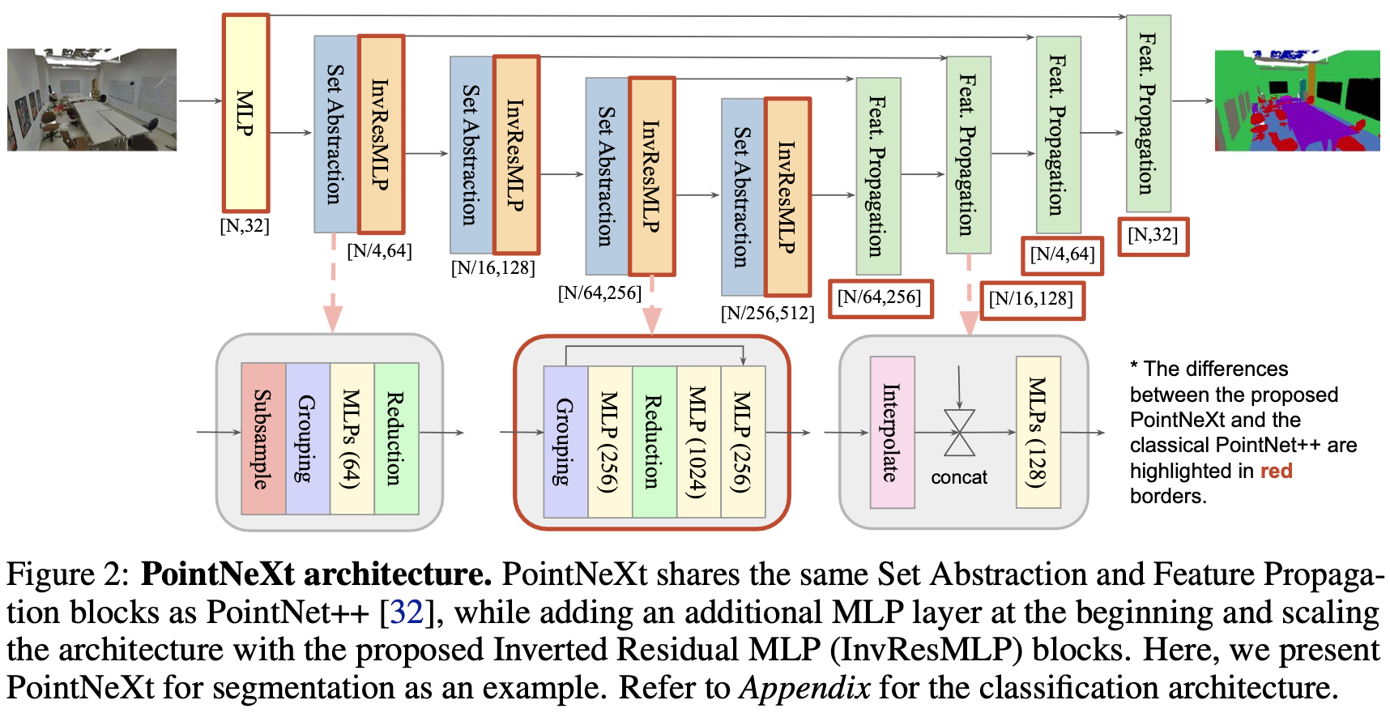
Methodology: From PointNet++ to PointNeXt
Architecture Modernization: Small Modifications → Big Improvements
Notes:
SA → 2 to 4
Symmetric decoder == channel size == encoder
Stem MLP (additional)

Slide 9
Methodology: From PointNet++ to PointNeXt
Architecture Modernization: Small Modifications → Big Improvements
InvResMLP vs. SA
Add residual connection b/n i/o → alleviate vanishing gradient problem (deeper network)
Separable MLPs → reduce computation and reinforce pointwise feature extraction
The inverted bottleneck design → expand the output channels of the second MLP by 4 times.
Notes:
A larger C leads to an increase in the width of the network (i.e., width scaling), while a larger B leads to an increase in the depth of the network (i.e., depth scaling).

Slide 10
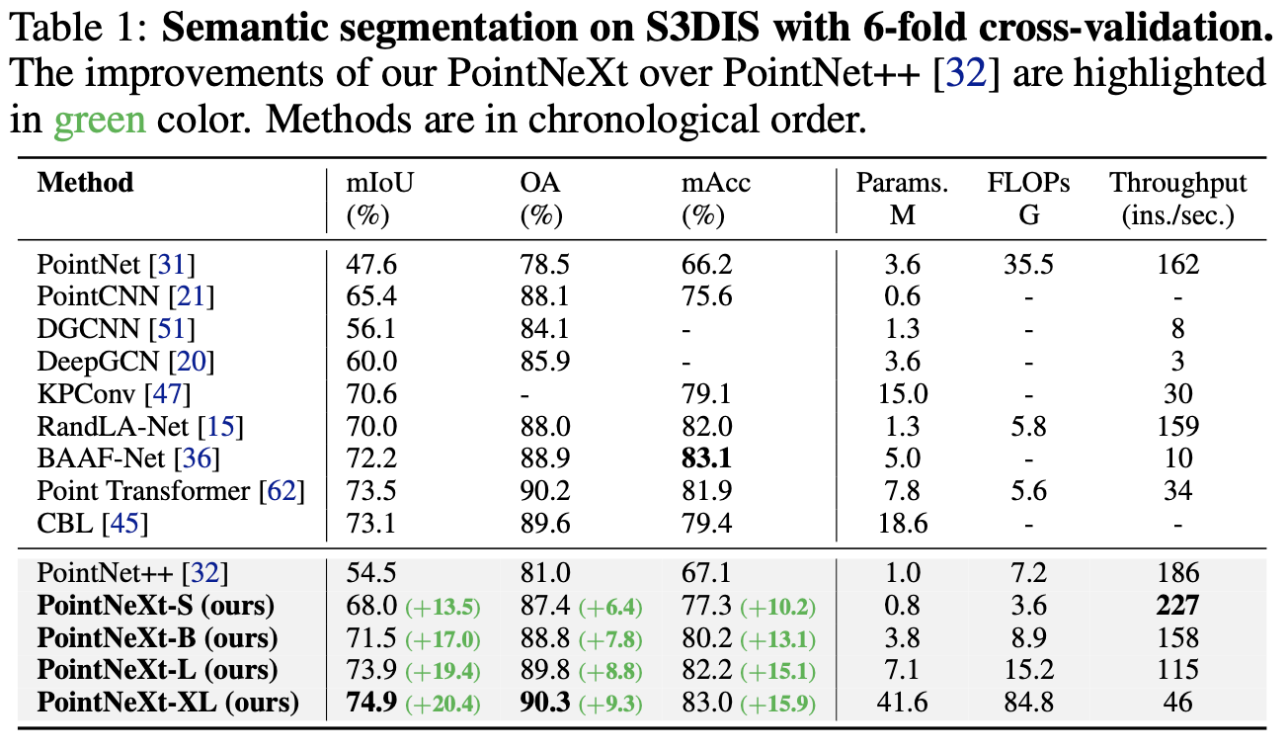
Results: 3D Semantic Segmentation on S3DIS

Slide 11
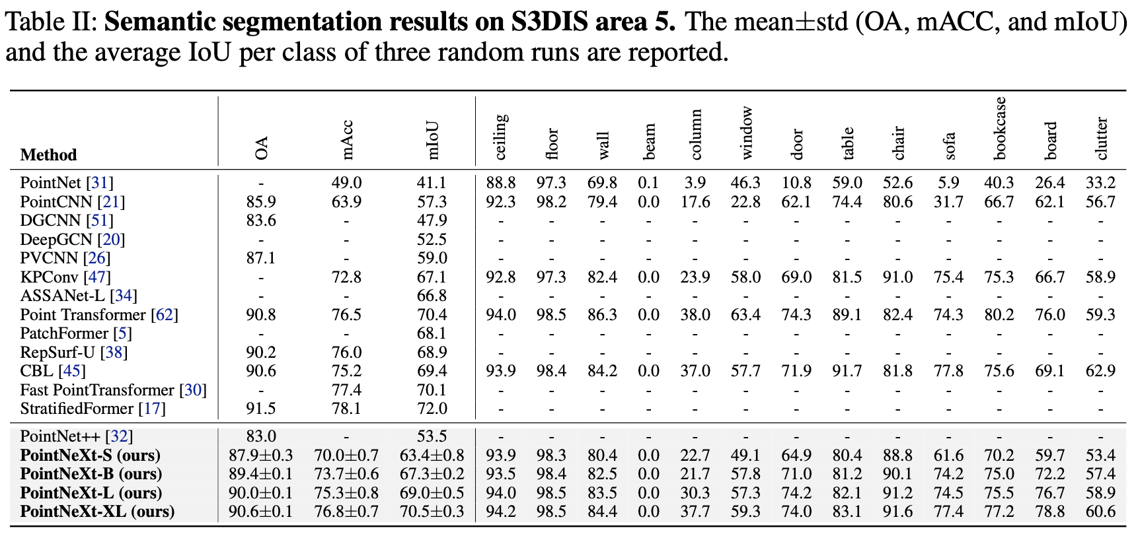
Results: 3D Semantic Segmentation on S3DIS

Slide 12
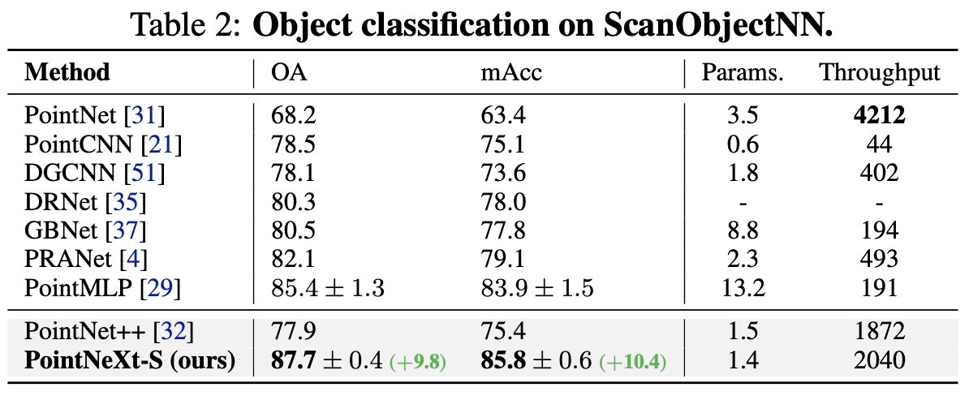
Results: 3D Object Classification on ScanObjectNN

Slide 13
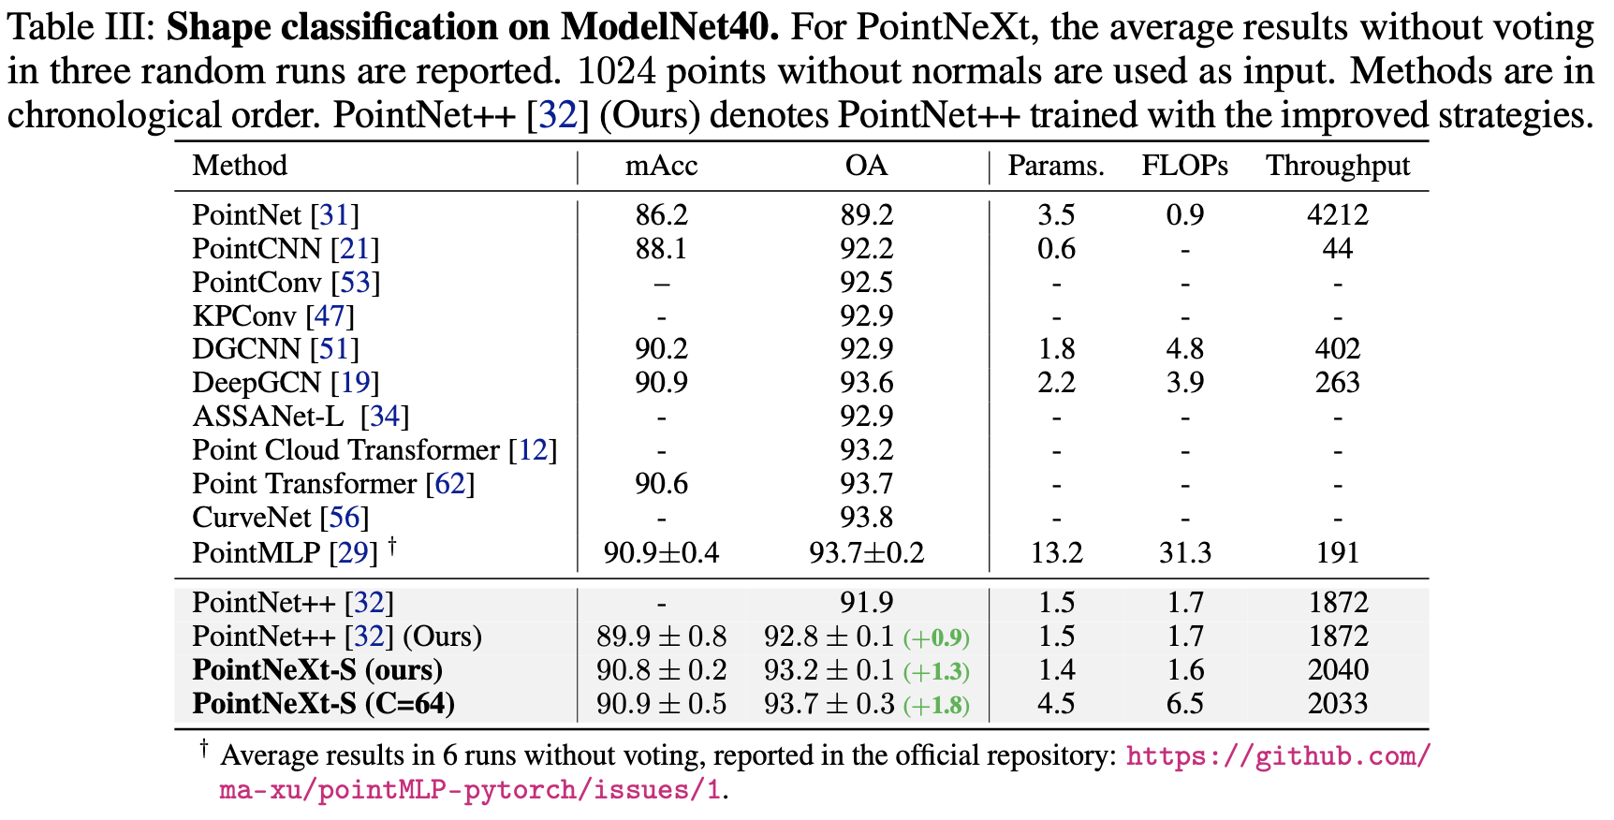
Results: 3D Object Classification on ModelNet40

Slide 14
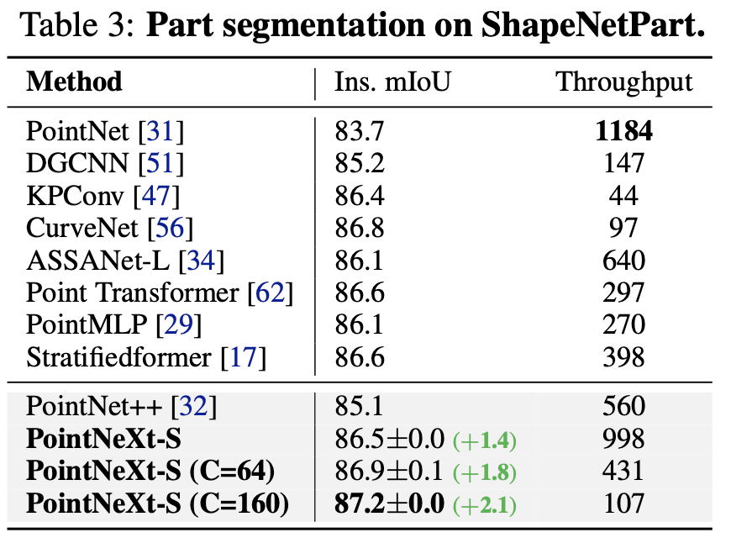
Results: 3D Object Part Segmentation on ShapeNetPart

Slide 15
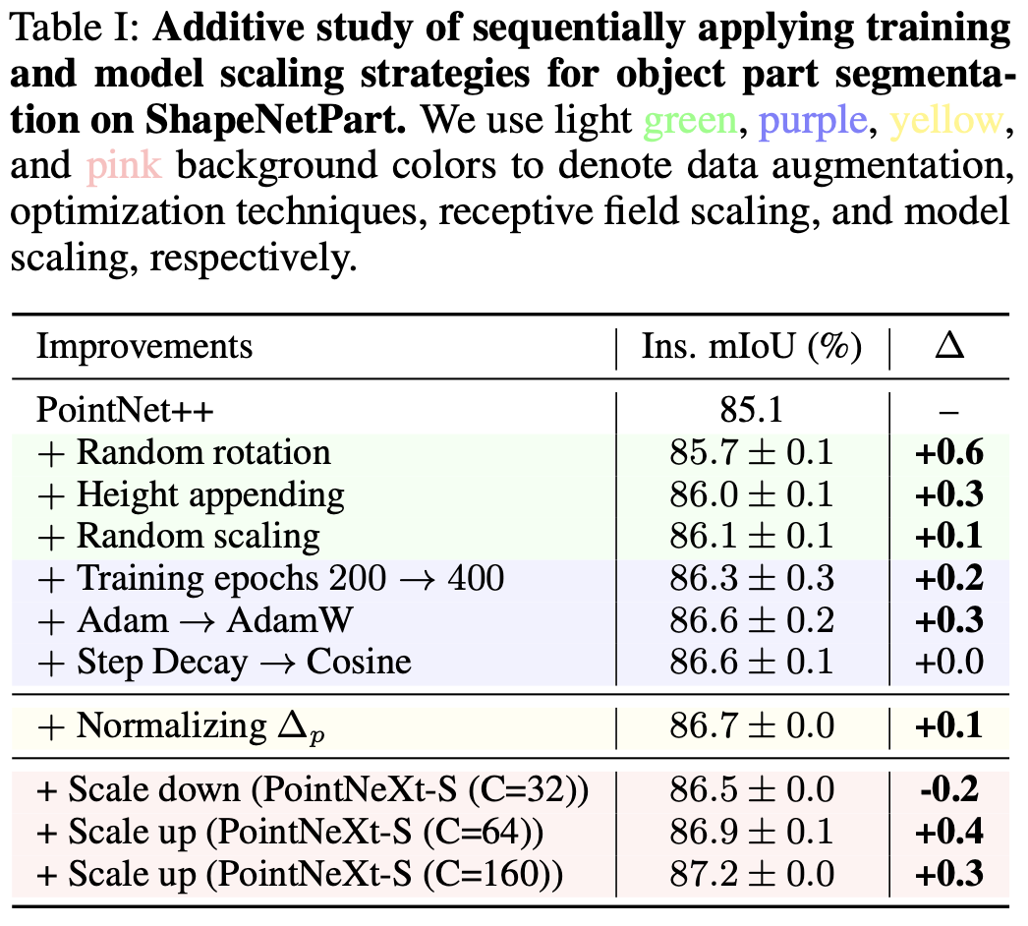
Results: 3D Object Part Segmentation on ShapeNetPart

Slide 16
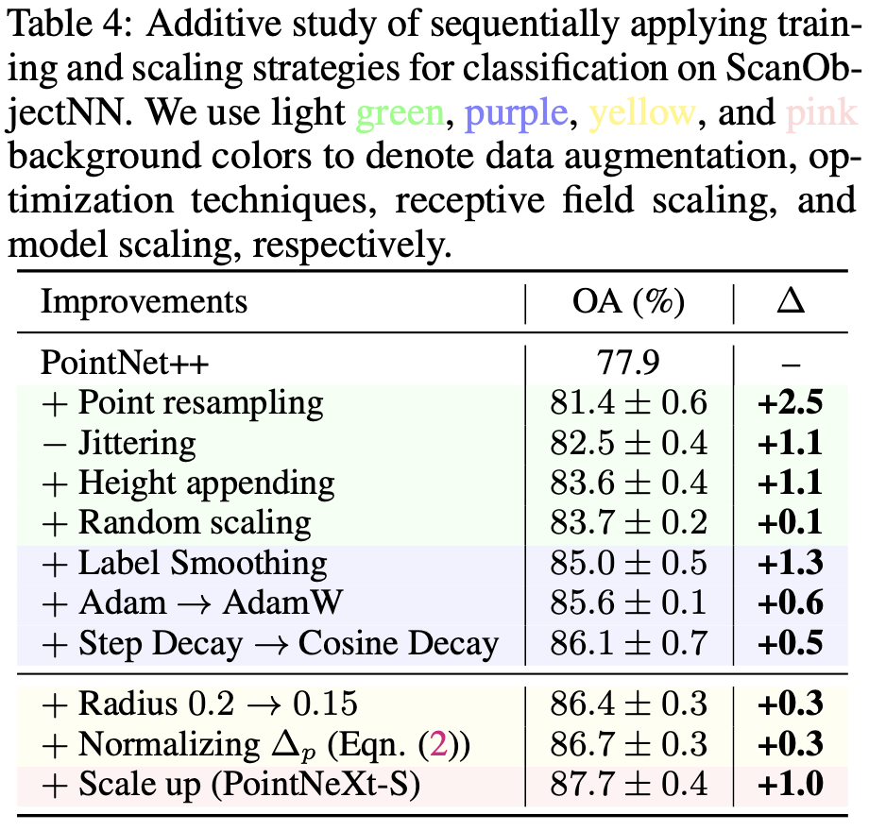
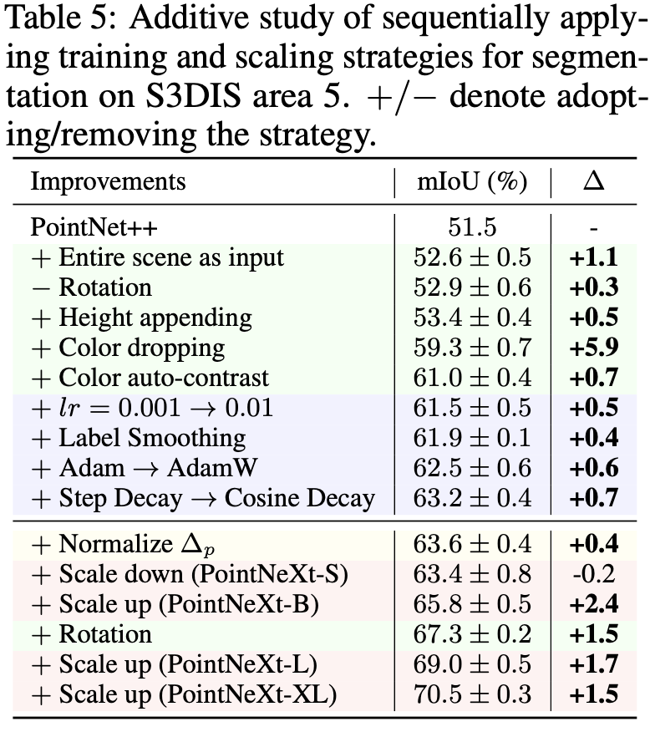
Results: Ablation and Analysis → Training Strategies & Optimization

Slide 17
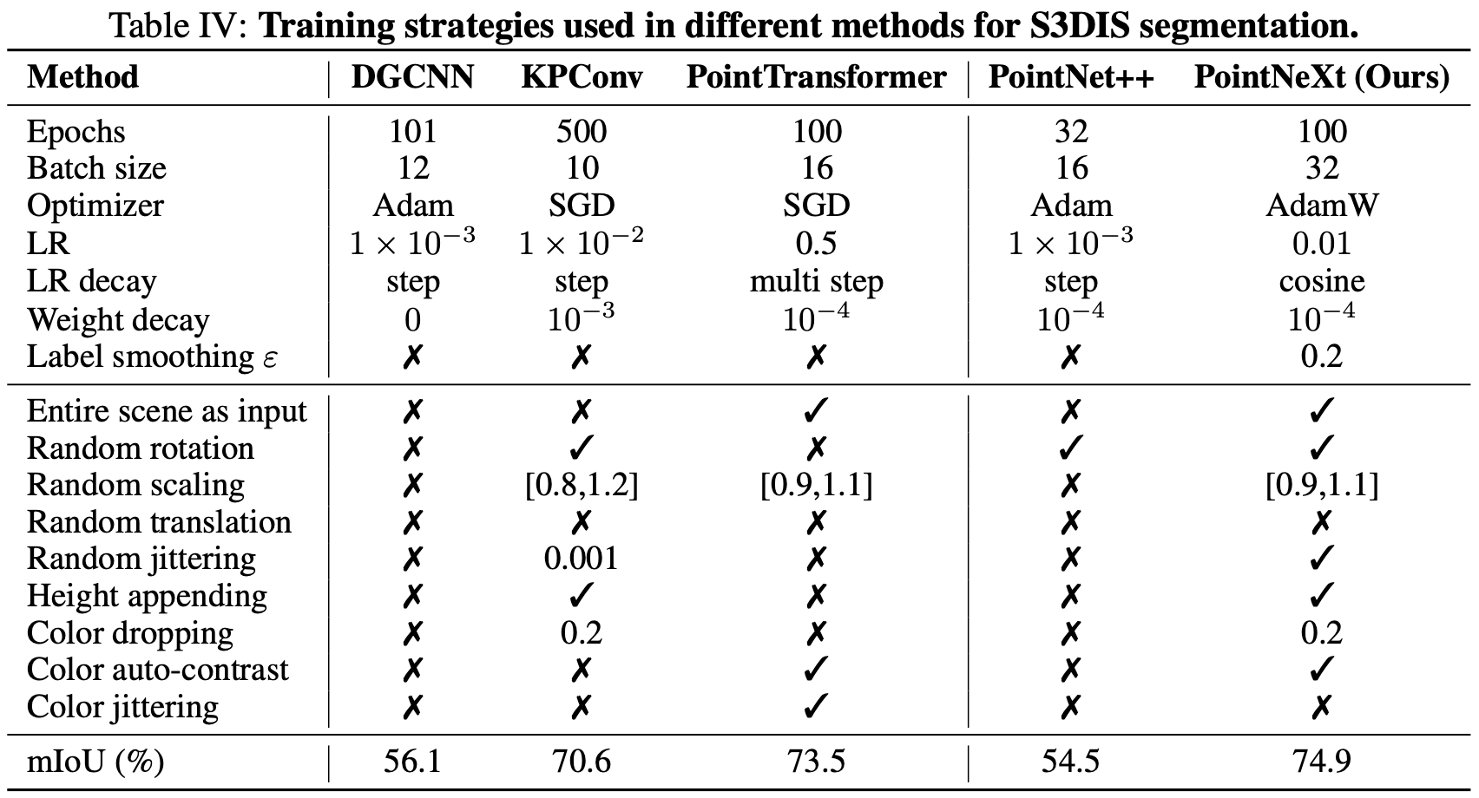
Results: Ablation and Analysis → Training Strategies & Optimization

Slide 18
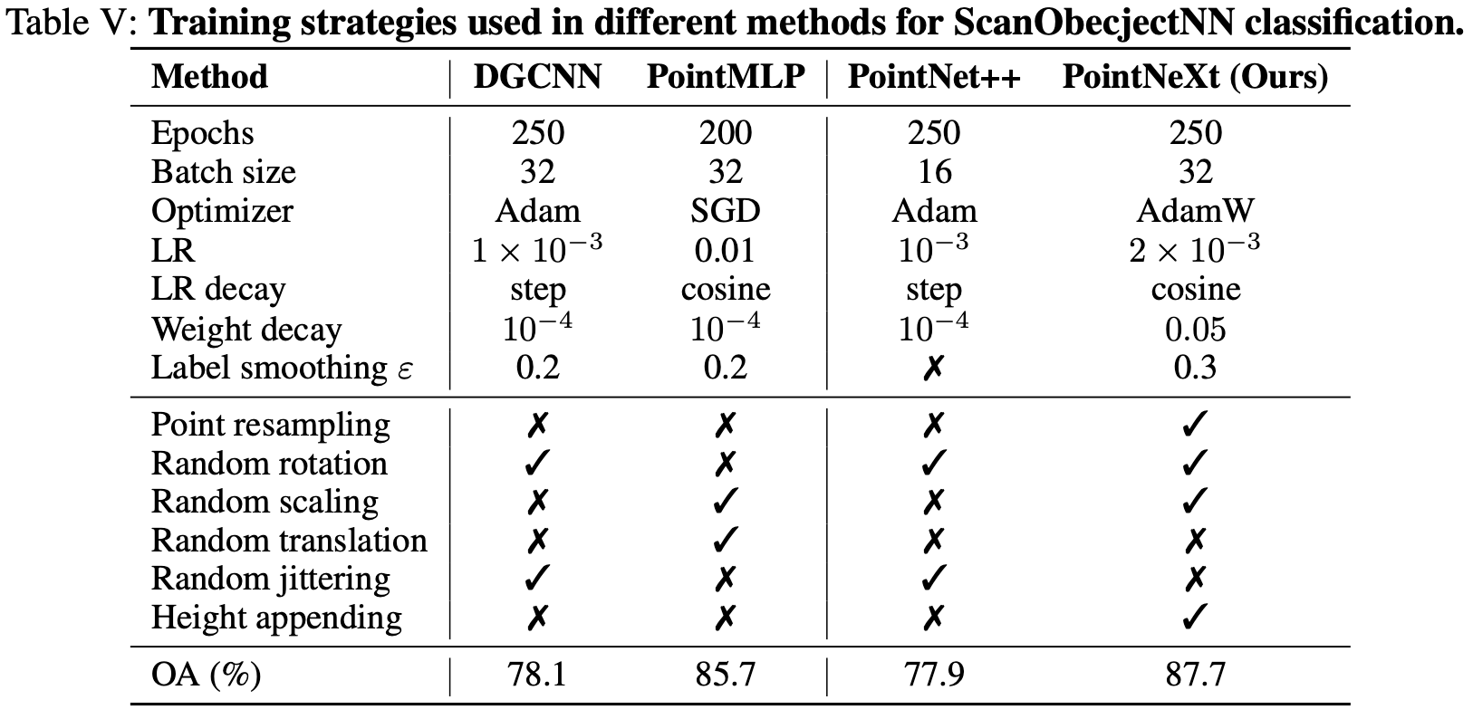
Results: Ablation and Analysis → Training Strategies & Optimization

Slide 19
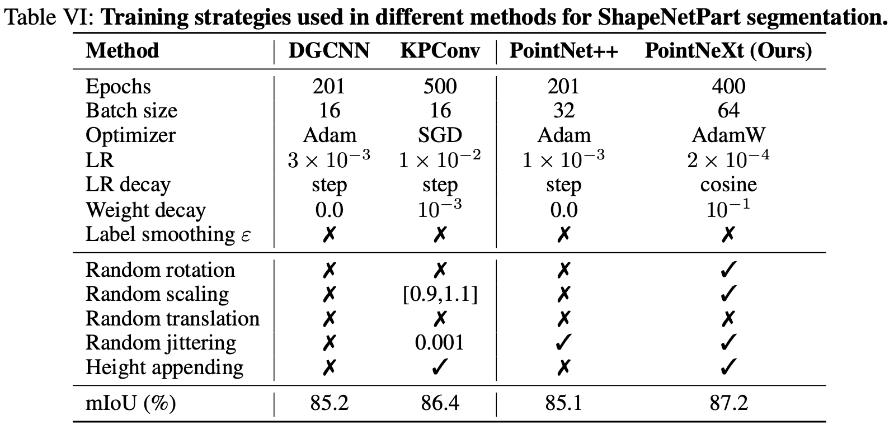
Results: Ablation and Analysis → Training Strategies & Optimization

Slide 20
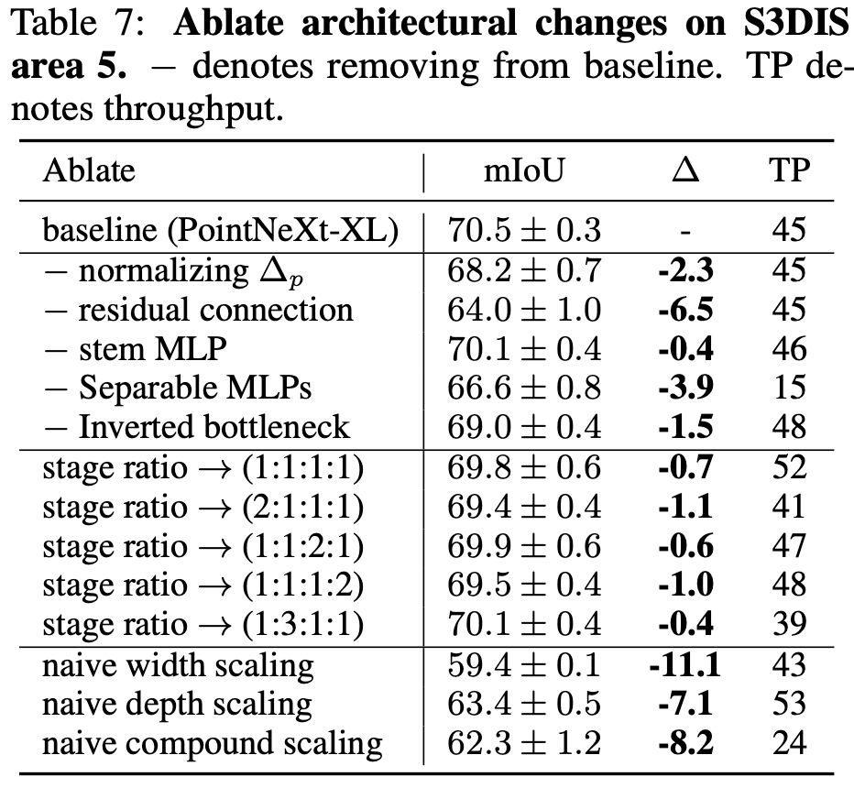
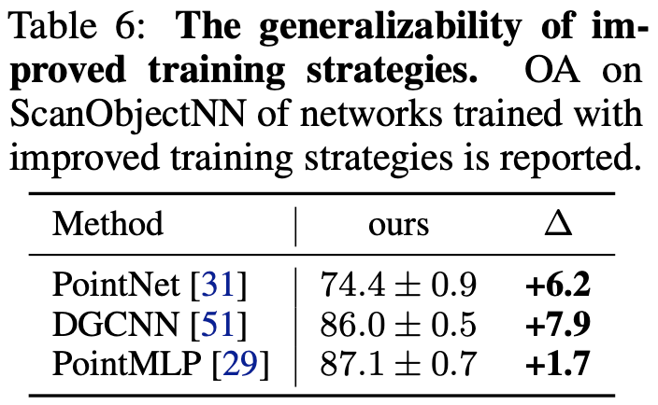
Results: Ablation and Analysis → Generalizability & Model Scaling

Slide 21
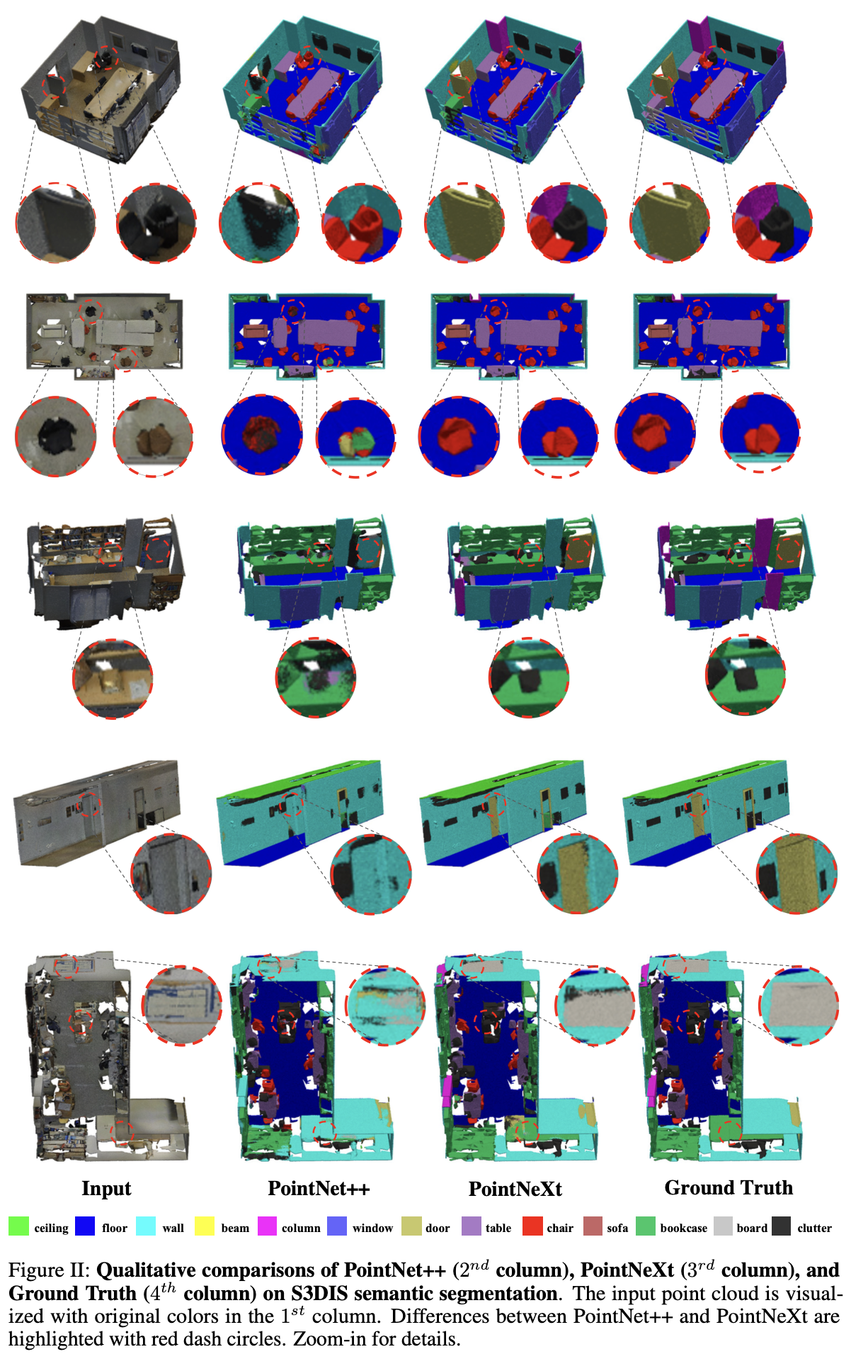

Slide 22
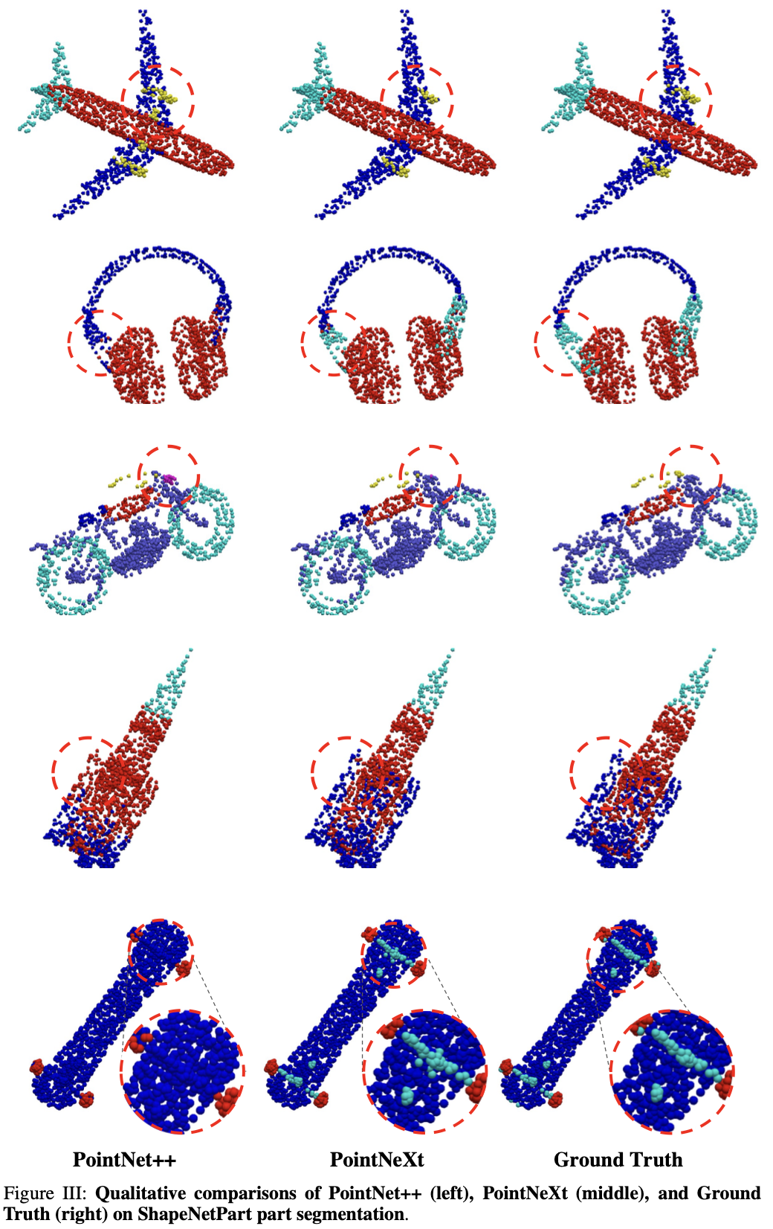

Slide 23
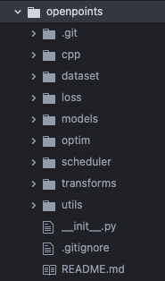
Openpoints

Slide 24
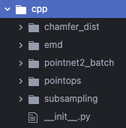
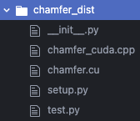
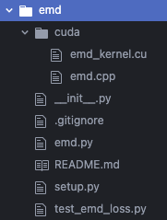
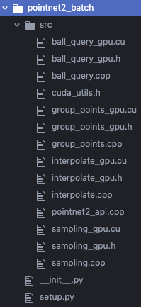
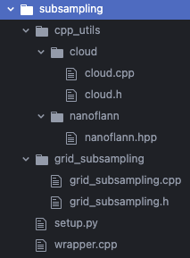

Slide 25
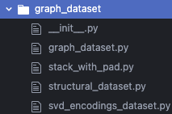
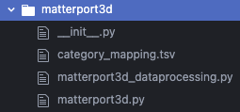
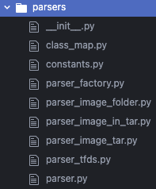
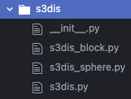

Slide 26
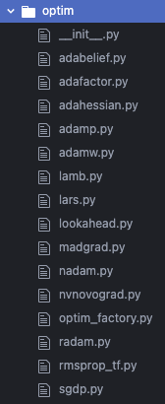
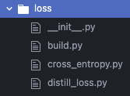
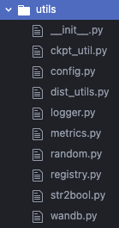
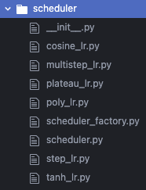
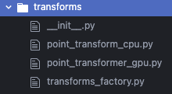

Slide 27
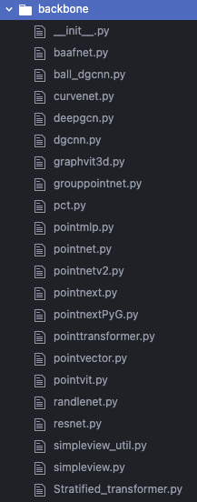
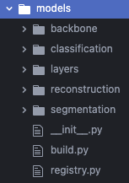
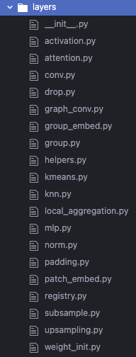
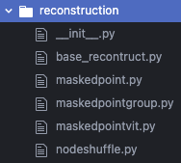

Slide 28
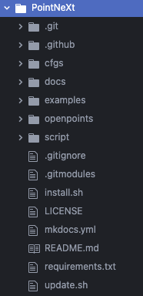
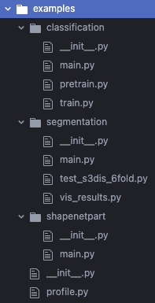
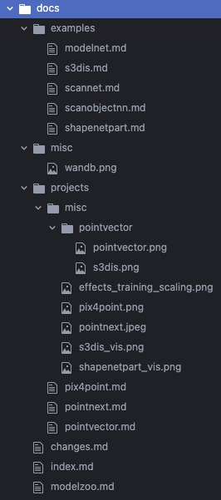
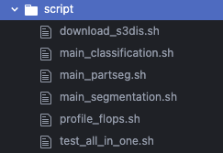

Slide 29
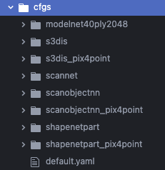
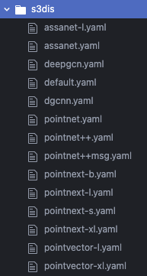
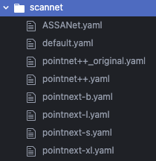
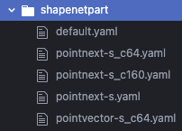

Slide 30
Q&A

