Slide 1
ICCV 2021
Citations: 1410
Source: https://arxiv.org/pdf/2012.09164.pdf

Slide 2
Notes:
Highly expressive Point Transformer layer for point cloud processing.
Invariant to permutation and cardinality
Construct high-performing Point Transformer networks
classification and dense prediction on point clouds.
→ serve as general backbones for 3D scene understanding.
Extensive experiments over multiple domains and datasets.
Conduct controlled studies to examine specific choices in the Point Transformer design and set the new SOTA on multiple highly competitive benchmarks, outperforming long lines of prior work.

Slide 3
Background
Self-attention operators
scalar attention
scalar dot-product attention layer
vector attention
Point Transformer Layer
Notes:
set of feature vectors.
β is a relation function (e.g., subtraction) and γ is a mapping function

Slide 4
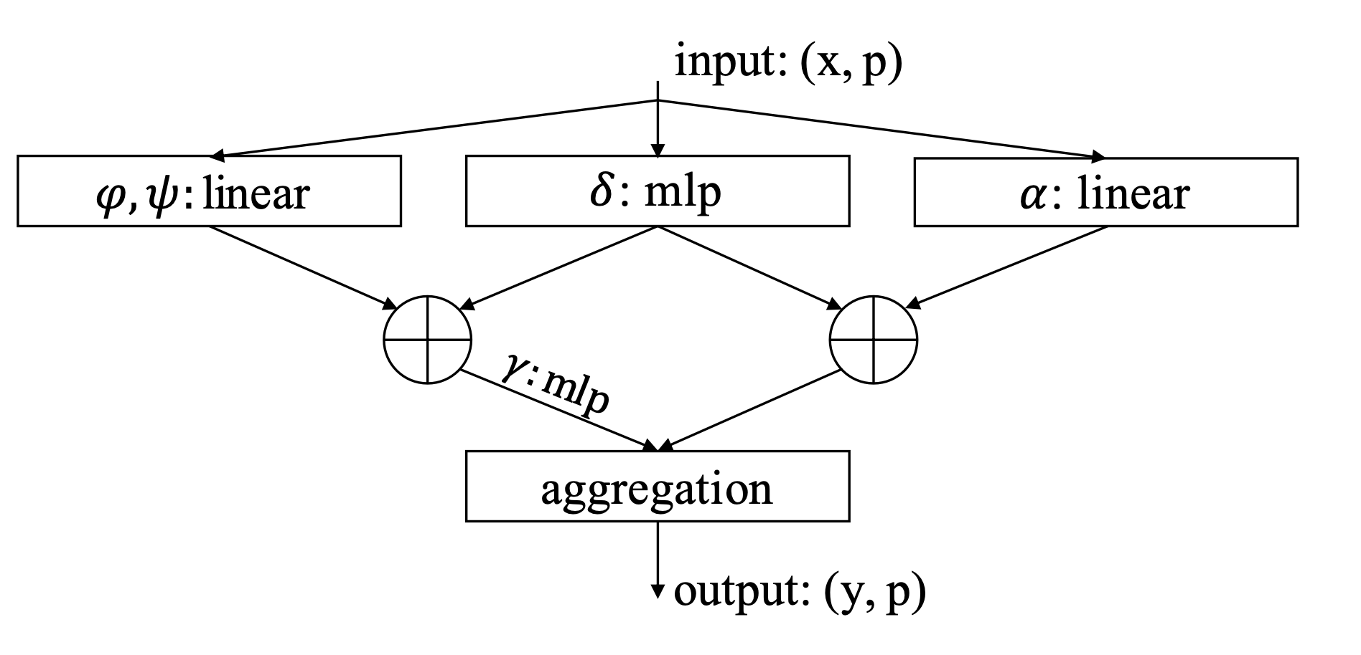
Point Transformer Layer

Slide 5
Classification Network
Semantic Segmentation

Slide 6
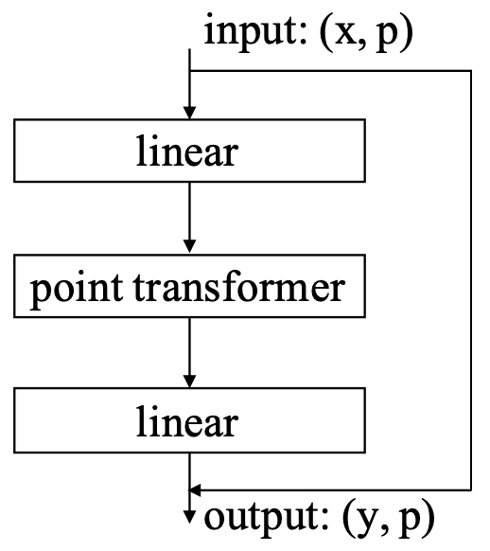
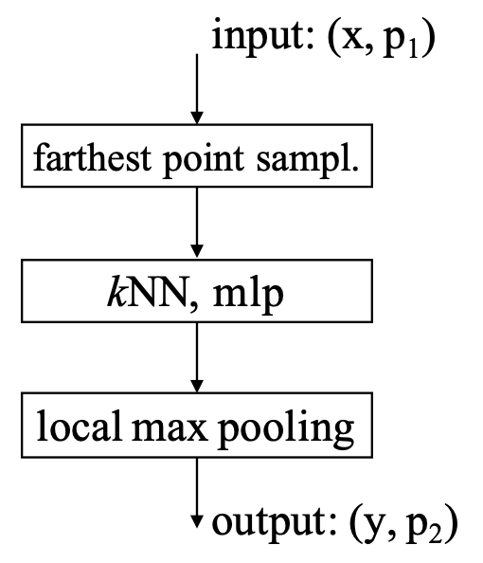
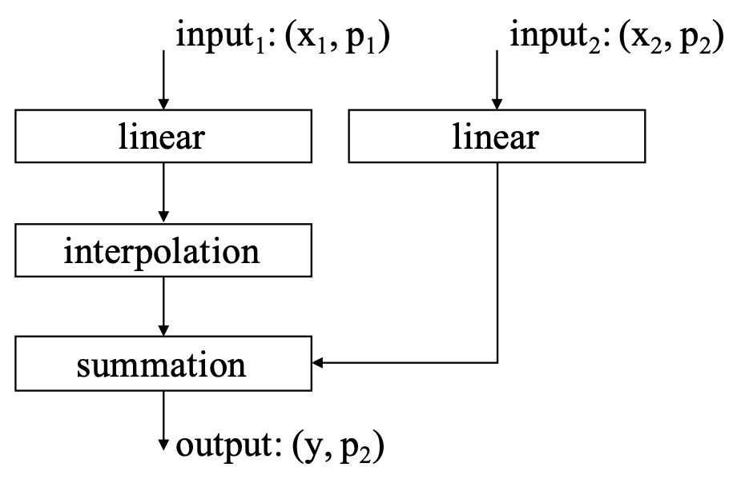
Position Encoding
Point Transformer Block
Transition down
Transition Up

Slide 7
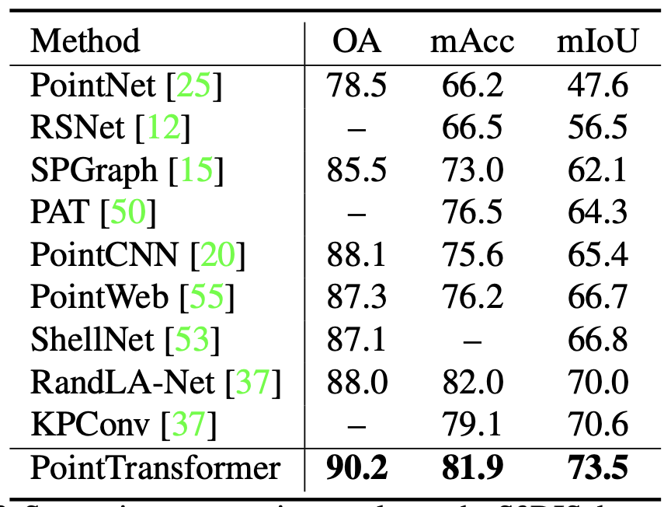
Semantic Segmentation
Results
S3DIS
- 271 rooms
- six areas
- three different buildings.
- 13 categories
Area 5 heldout
6-fold cross-validation

Slide 9
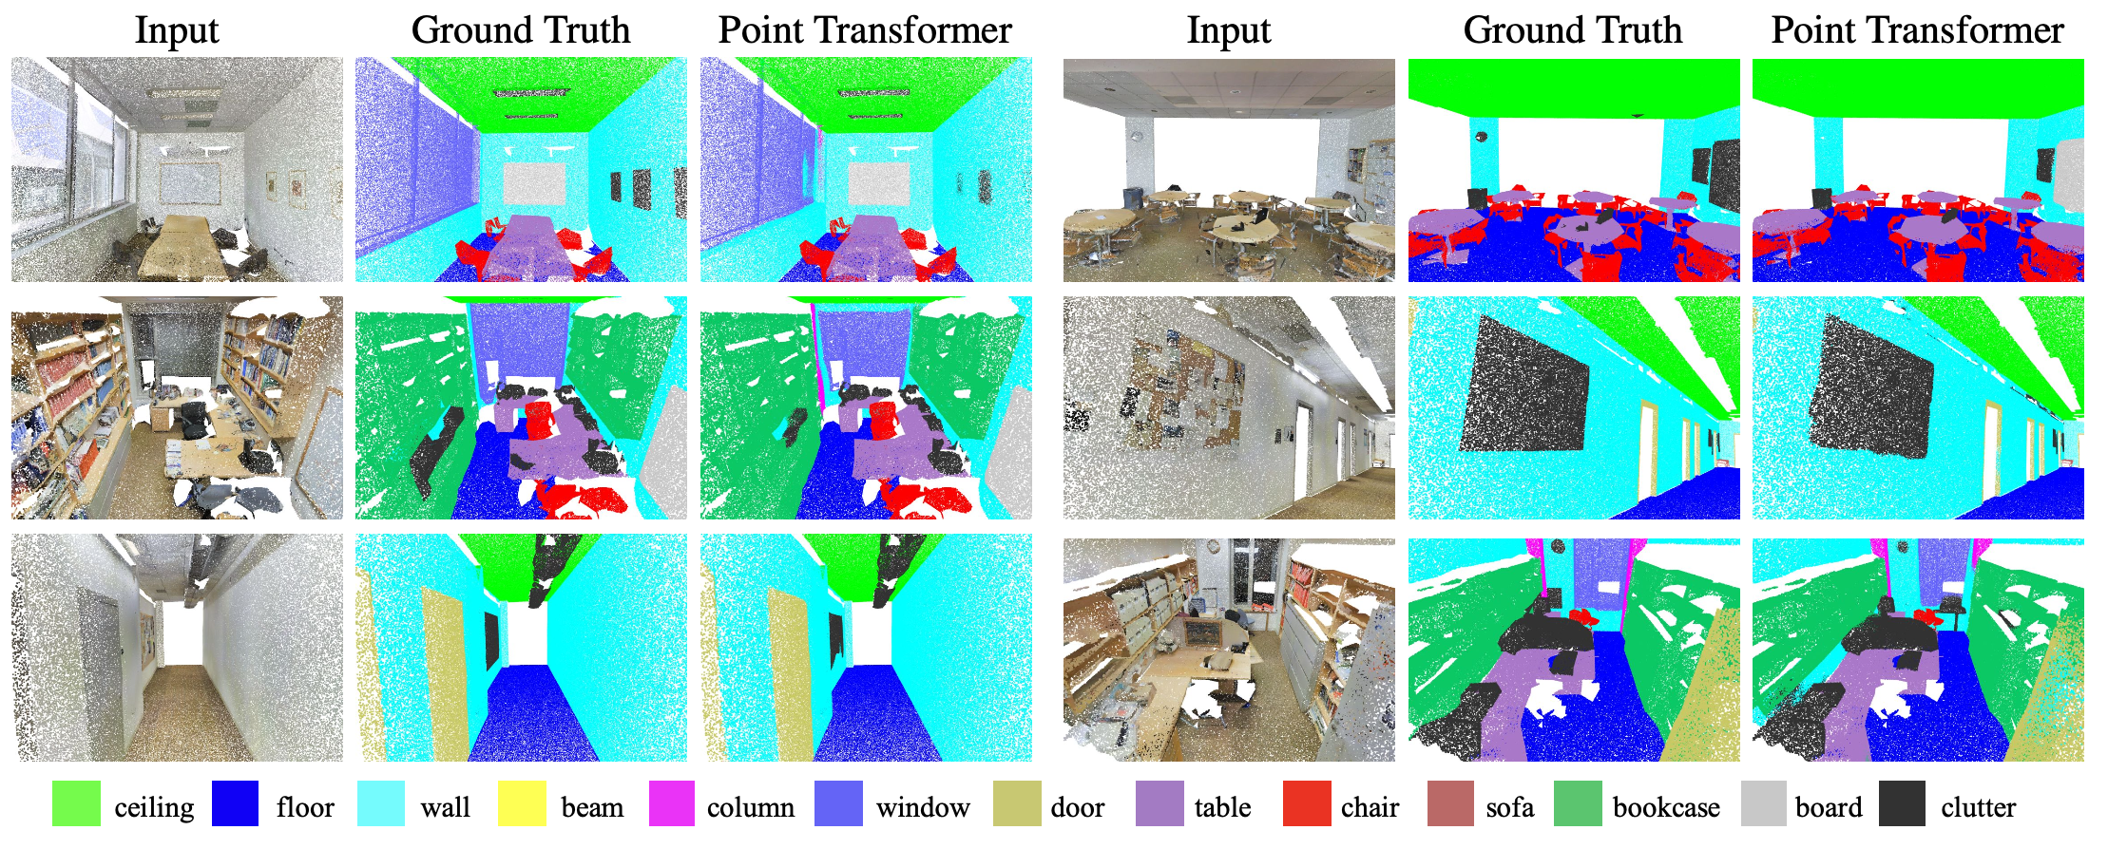

Slide 10
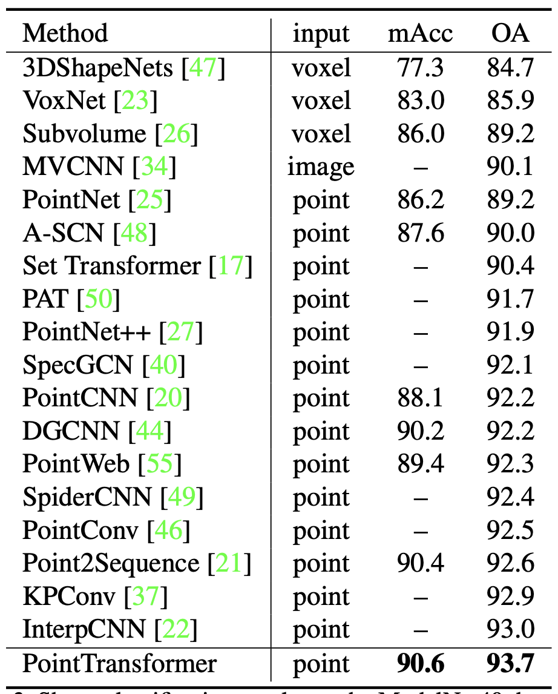
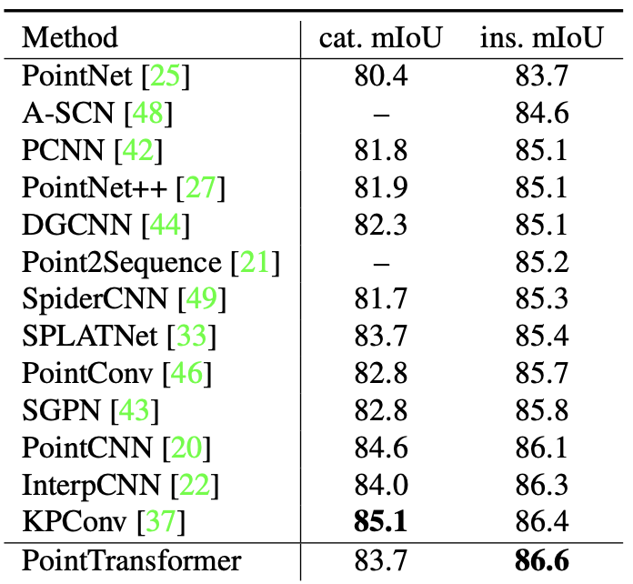
Object Classification
Object Part Segmentation

Slide 11
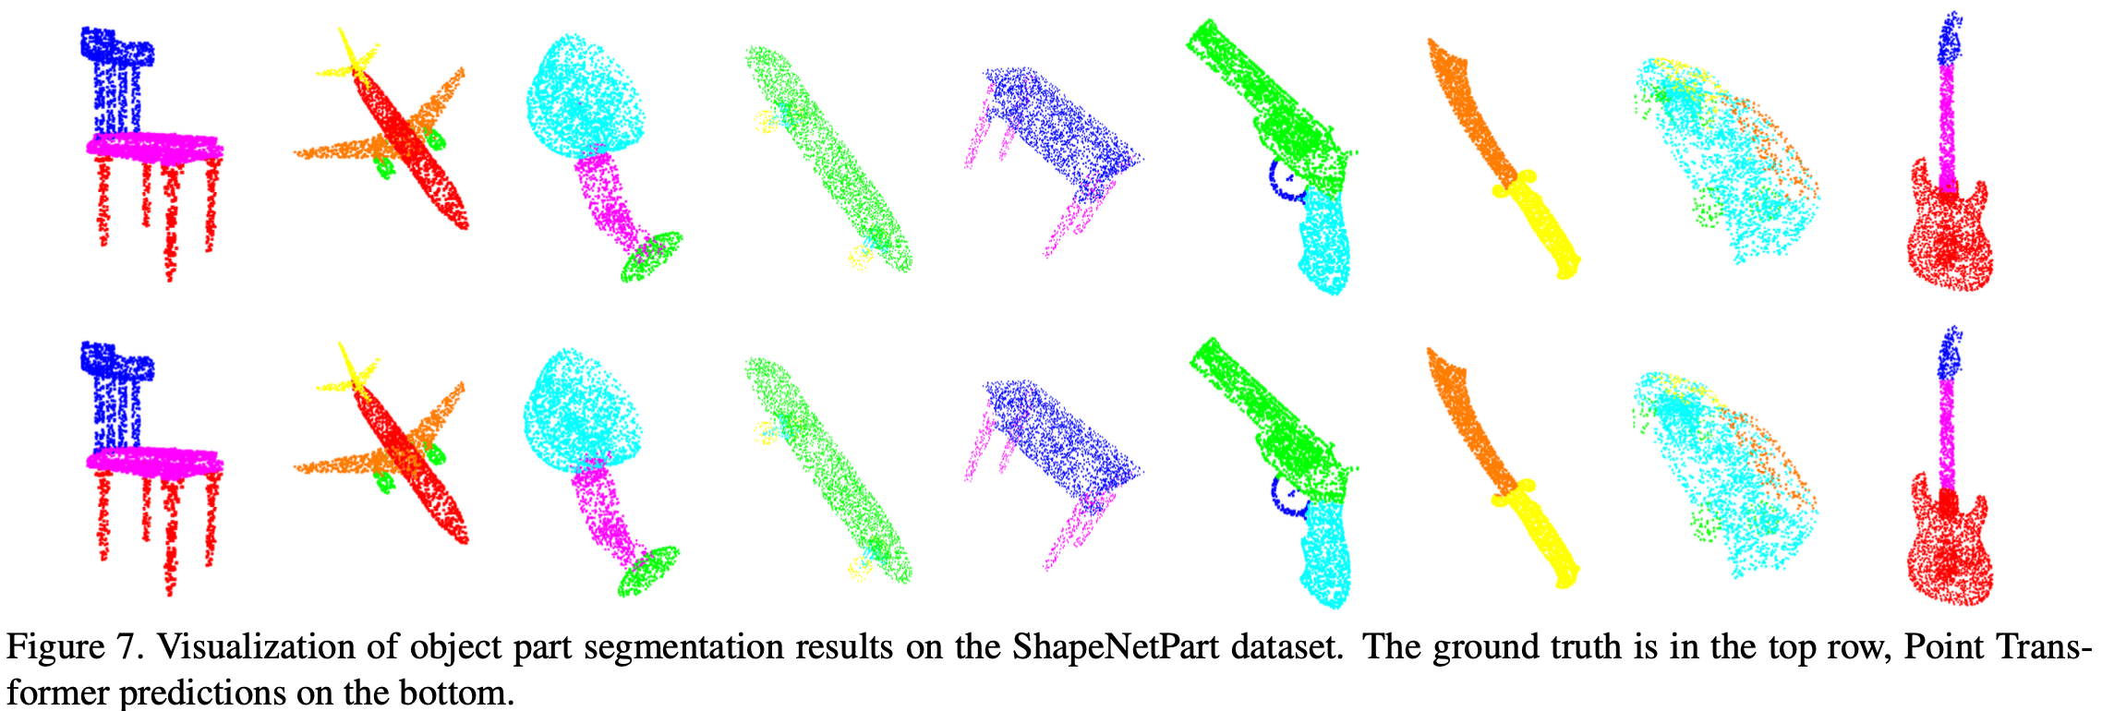

Slide 12
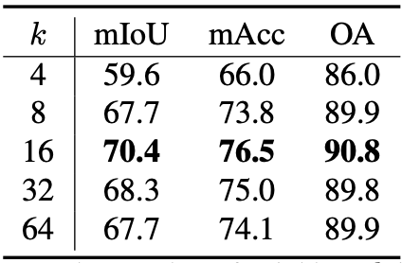
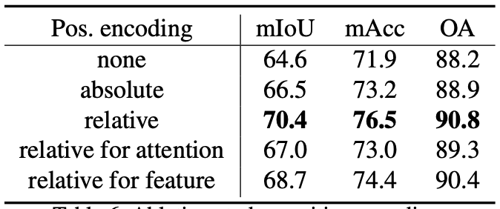
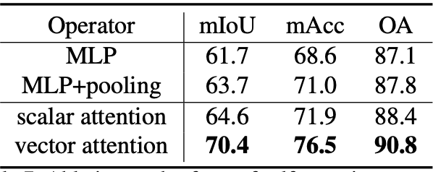
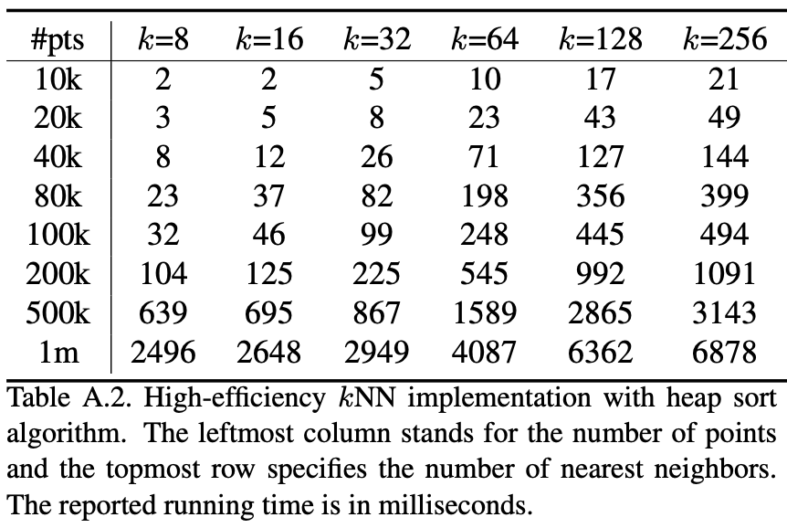
Ablation Study

Slide 14
Q&A

Slide 15
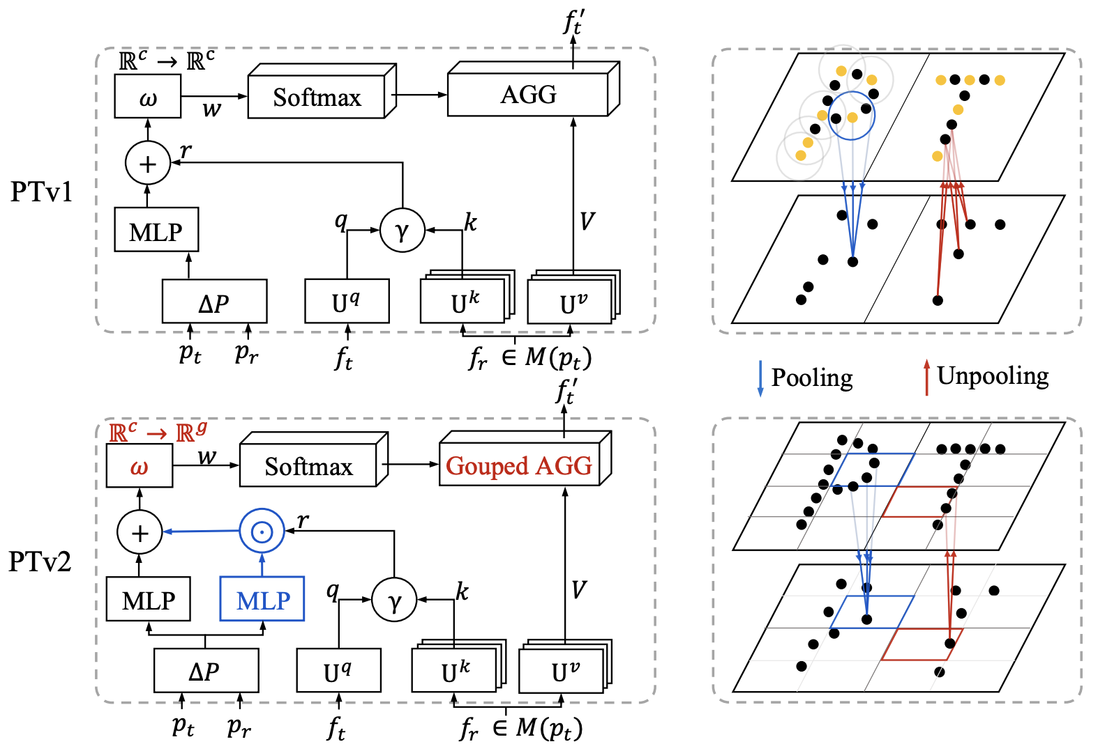
Point Transformer V2: Grouped Vector Attention and Partition-based Pooling
Source: https://openreview.net/pdf?id=I3mLa12s_H

Slide 16
scalar attention
vector attention
grouped vector attention

Slide 17
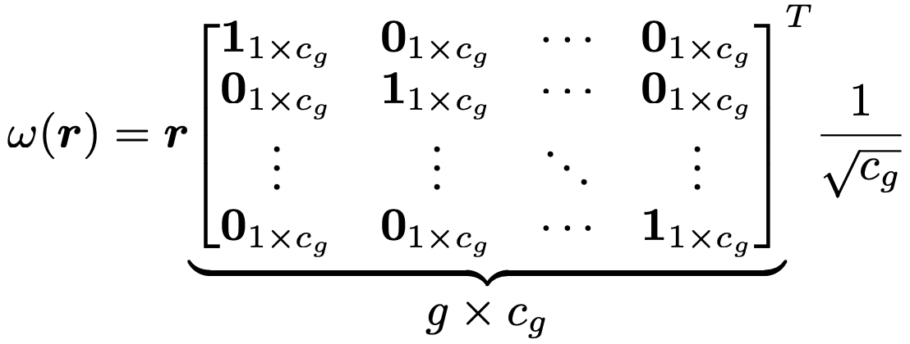
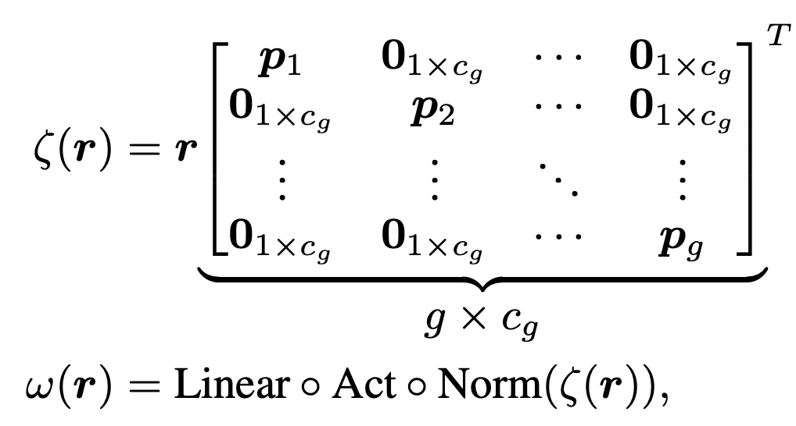

Slide 18
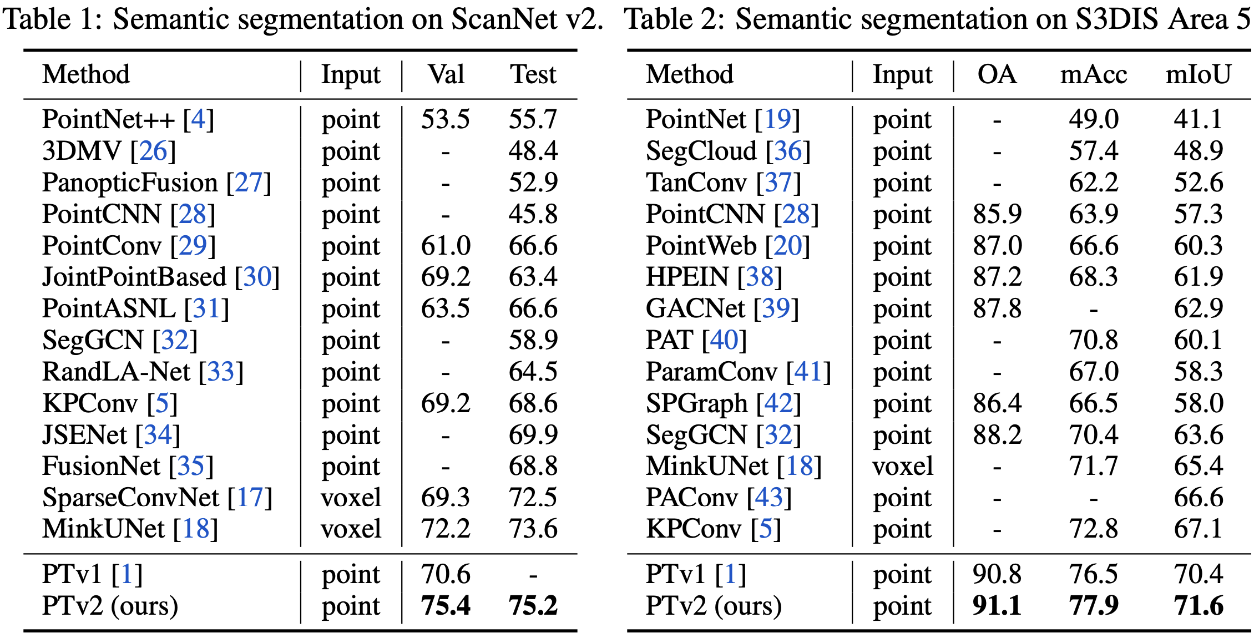

Slide 19
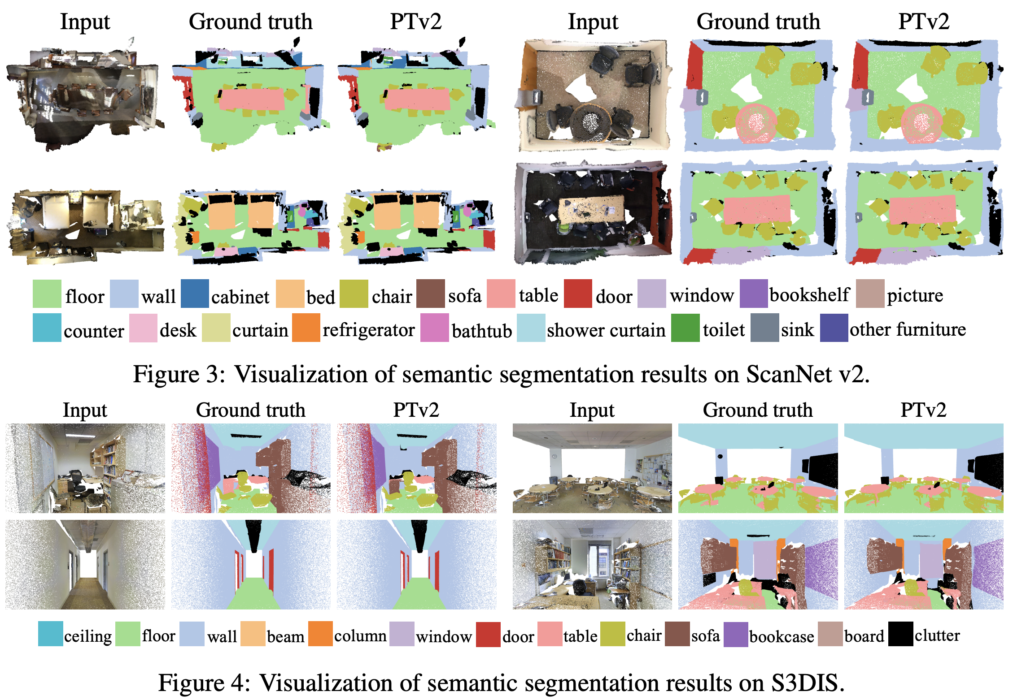

Slide 20
