Slide 1
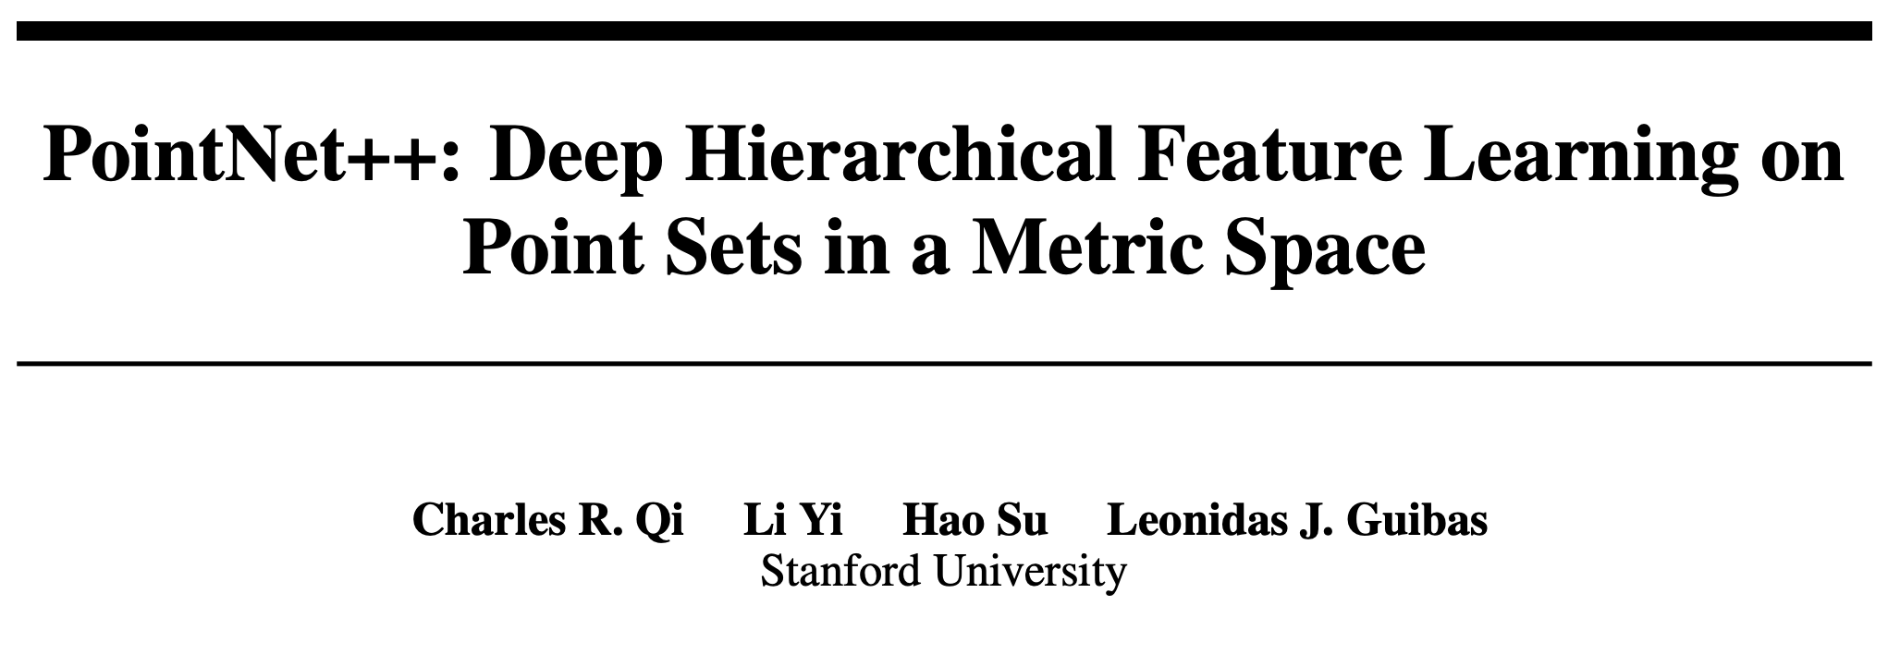

Slide 2
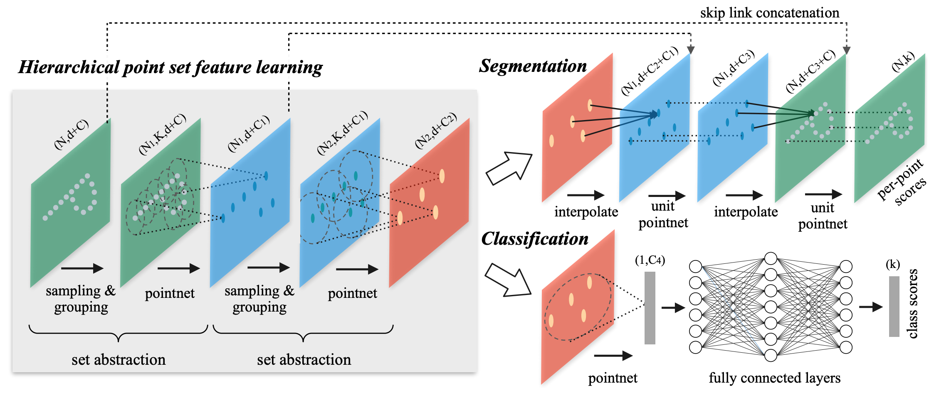
PointNet++ Architecture
NIPS 2017 (NeurIPS now)
10,136 citations
Qi, Charles R., et al. [15]

Slide 3
PointNet++
1) Partition(set of points) → overlapping local regions
2) Extract local features from small neighborhoods
3) Group into larger units
4) Process these units to produce higher level features
5) Repeat 1,2,3,4 for whole pointset
How to process to produce higher level features?
→ PointNet
How to generate overlapping Partition?
→ neighborhood

Slide 4
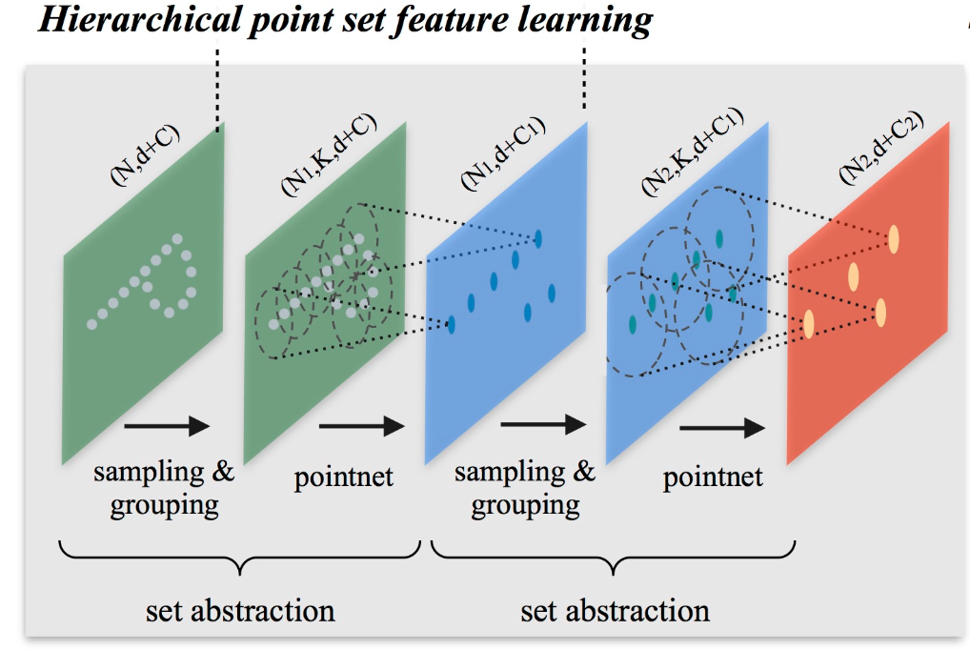
N x (d+C)
PointNet++
builds a hierarchical grouping of points
progressively abstract larger and larger local regions along the hierarchy
Set Abstraction
N′ x (d+C′)
3 key layers
Sampling – selects a set of points (centroids) from i/p points
Grouping – constructs local region around centroids
Pointnet – encodes local region patterns into feature vectors
Qi, Charles R., et al. [15]

Slide 5
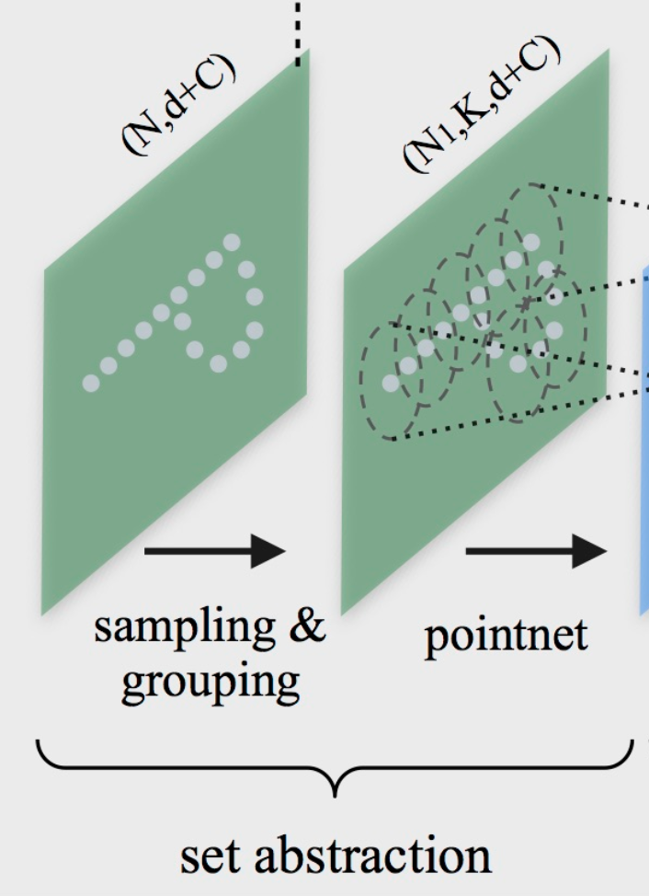
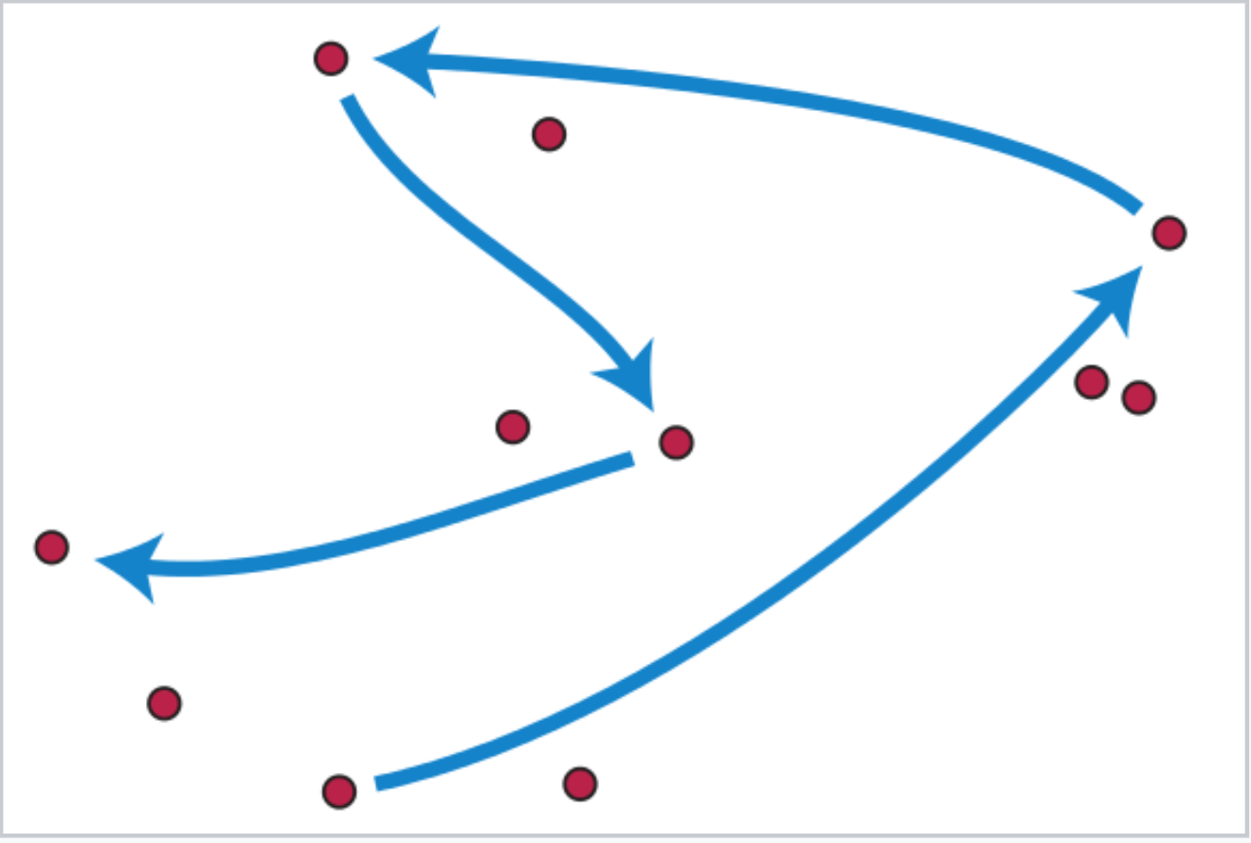
Sampling layer
Input points
{x_{i1} , x_{i2} ,...,x_{ij},…,x_{iM}} = farthest point sampling ({x₁, x₂, ..., x_{N}})
Most distant point
{x_{i1} , x_{i2} ,...,x_{ij-1}}
Source: wiki
Qi, Charles R., et al. [15]

Slide 6
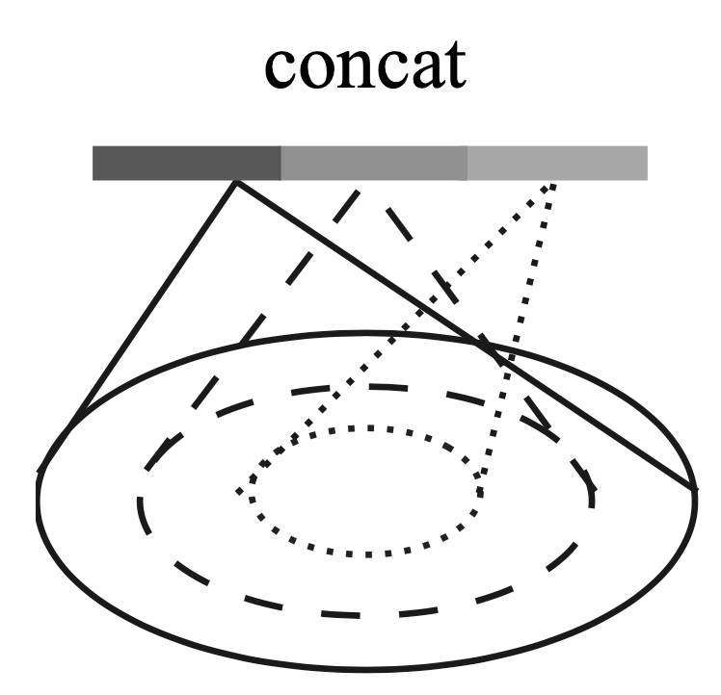
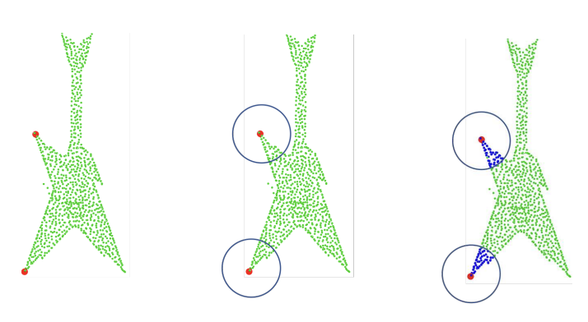
Grouping layer
Input:
Point set → N x (d + C)
Centroids → N′ x d
Output:
Groups of Point sets → N′ x K x (d + C)
Ball Query – all points within a radius to the query point
Range Query – kNN search – fixed number of neighboring points
Qi, Charles R., et al. [15]

Slide 7
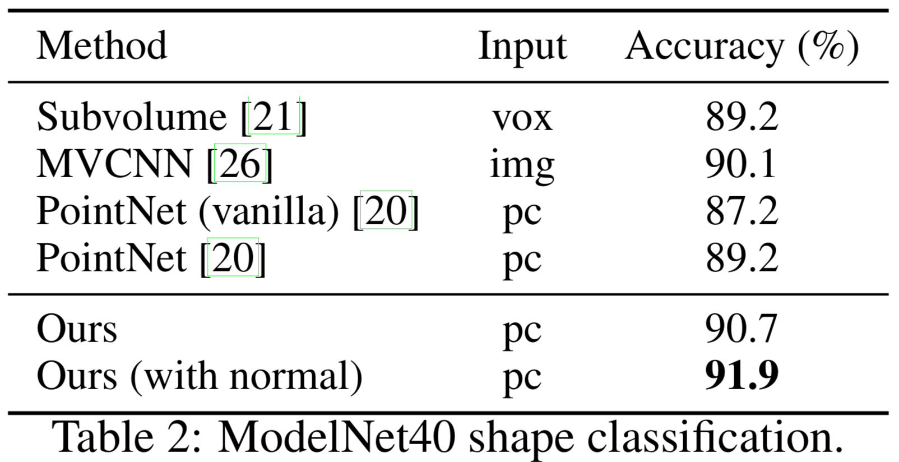
PointNet layer
Output:
N′ x (d + C′)
Input:
Local regions of points → N′ x K x (d + C )
for i = 1, 2, ..., K and j = 1, 2, ..., d
x_{i}^{(j)} = x_{i}^{(j)} − $\hat{x}$_{i}^{(j)}
PointNet++
Qi, Charles R., et al. [15]

Slide 8
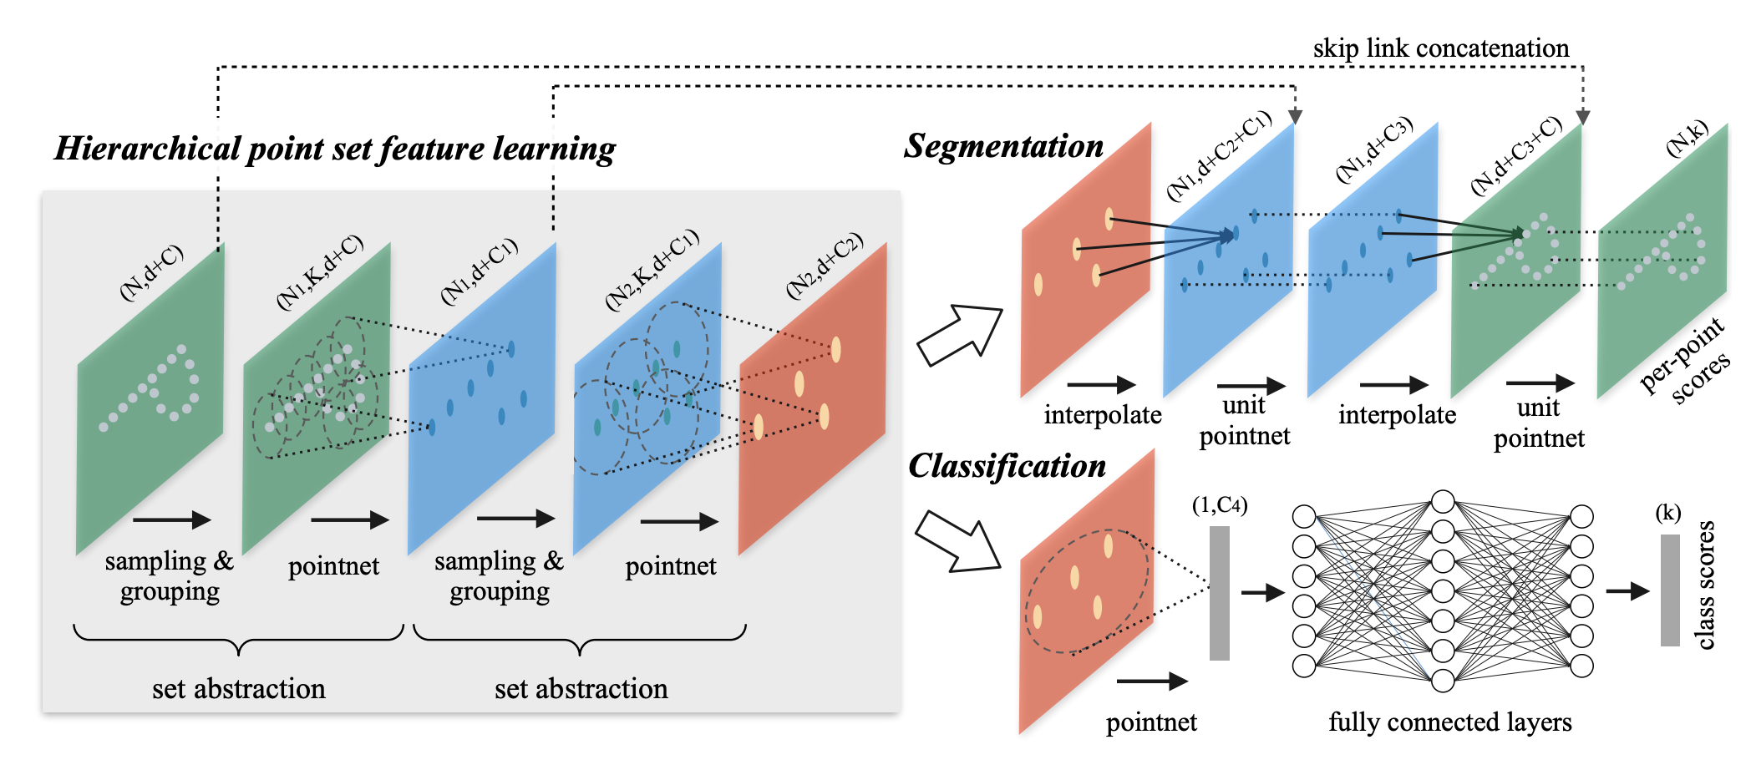
Segmentation

Slide 9
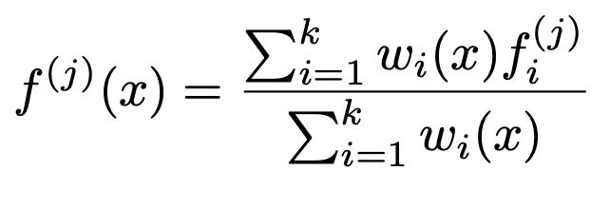
Segmentation

Slide 10
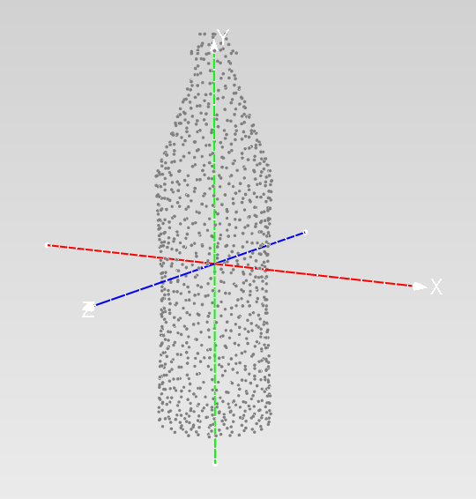
Dataset – ModelNet40
https://modelnet.cs.princeton.edu/
Dataset | Train | Test | Classes
ModelNet40 | 9843 | 2468 | 40
12,311 CAD models → 40 man-made object categories
uniformly sampled 1024 points
normalize points into a unit sphere
Data augmentation during training:
randomly rotate the object along the up-axis
jitter the position of each points by a Gaussian noise (𝜇=0 and 𝜎=0.02)

Slide 11
Classification Results

Slide 12
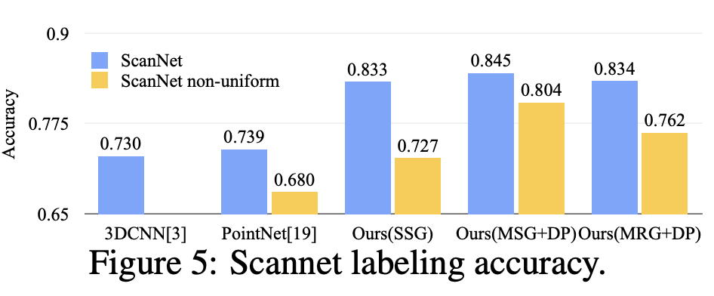
Semantic Part Segmentation

Slide 13
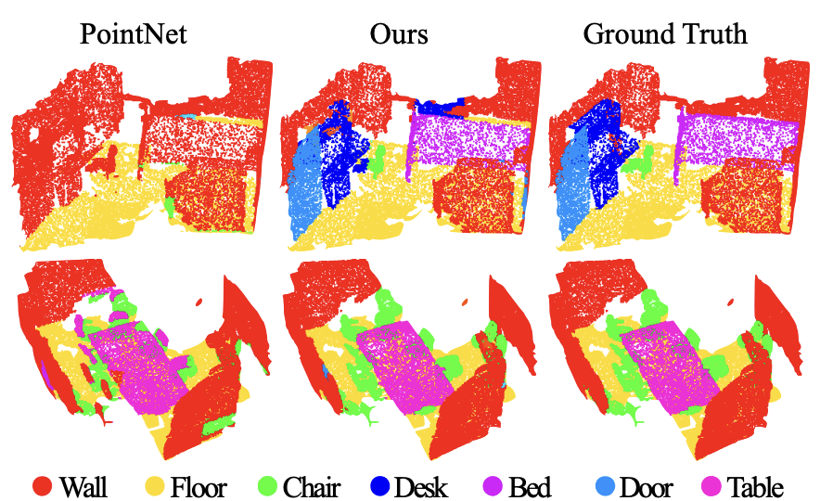

Slide 15
Q&A

