Slide 1
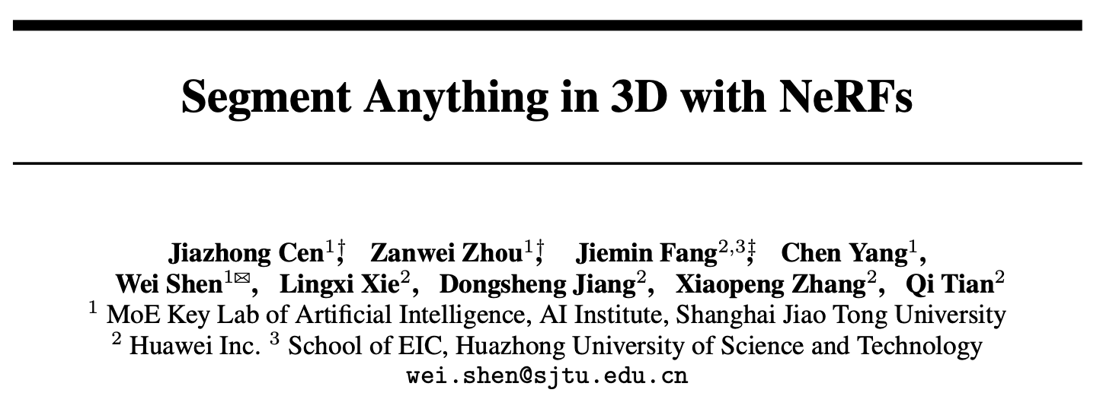
NeurIPs 2023
Citations: 47

Slide 2
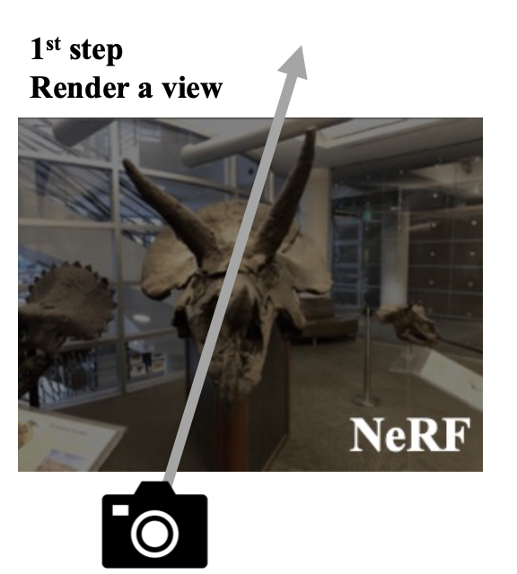
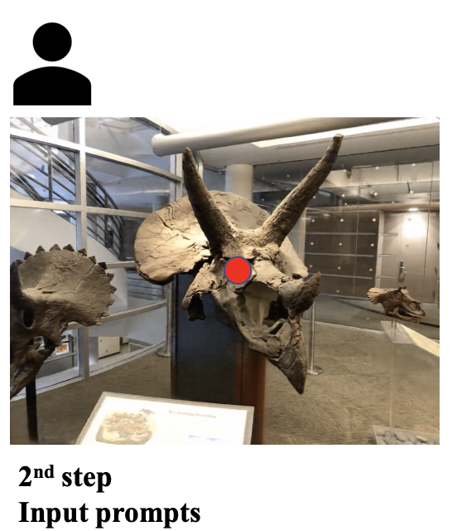
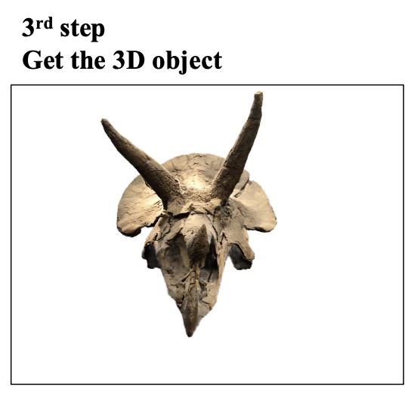

Slide 3
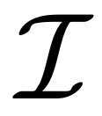
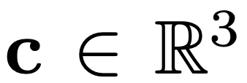
Neural Radiance Fields (NeRFs)
NeRFs
MLP
learnable
parameters
view direction
volume density
spatial coordinates
color
ray
Rendered image
camera origin
distance
direction

Slide 4
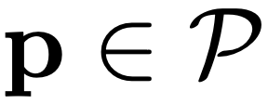
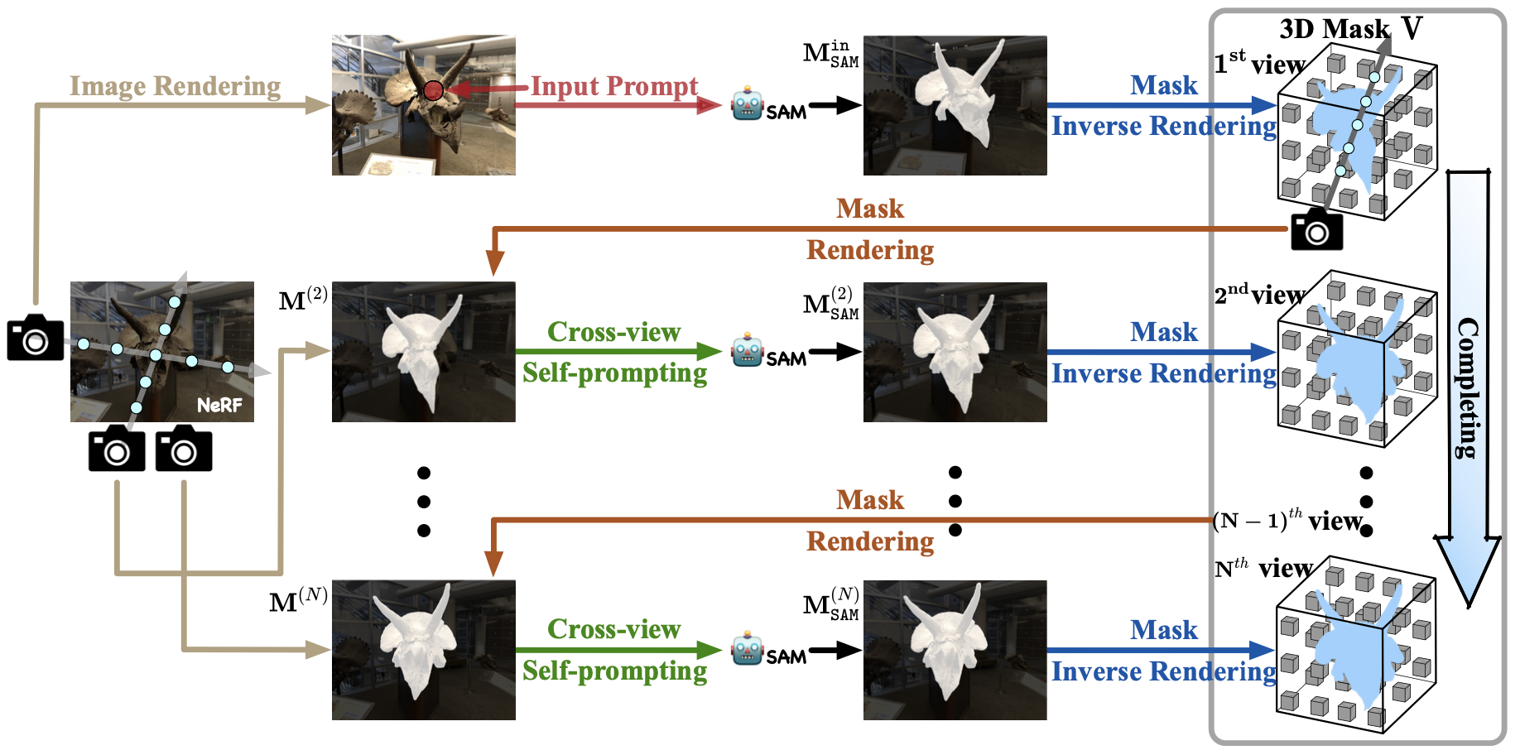
Segment Anything Model (SAM)
Mask
prompts
Notes:
no neural network needs to be optimized except the 3D mask

Slide 5
Mask Inverse Rendering
project the 2D mask to the 3D space
form the 3D mask based on weights
mask confidence score
Goal:
➔
mask generated by SAM
Notes:
ω(r(t)) reveals the object structure within the 3D space
density values of the pre-trained NeRF
high weight indicates the corresponding point close to the object’s surface.

Slide 6
ray set of the image
hyper-parameter
Notes:
assumption that both the geometry from the NeRF and the segmentation results of SAM are accurate
if SAM consistently predicts a region as foreground from different views, SA3D marks its corresponding 3D region as foreground

Slide 7
Cross-view Self-prompting
➔
camera intrinsics
estimated by the pre-trained NeRF
new prompt point
high confidence score
close to existing prompt points

Slide 8
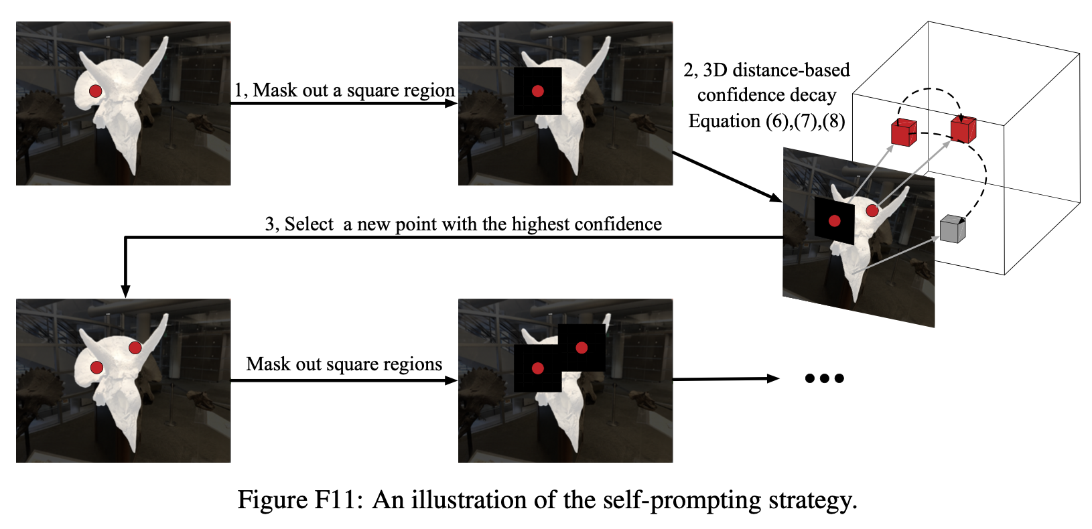

Slide 9
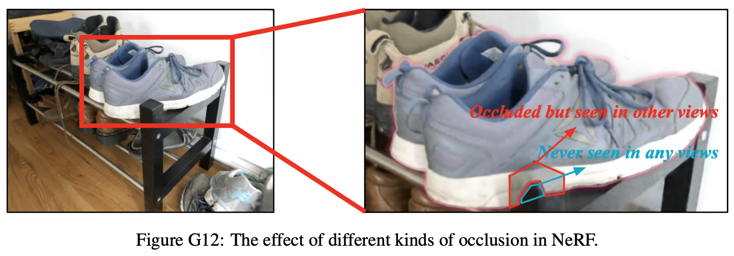
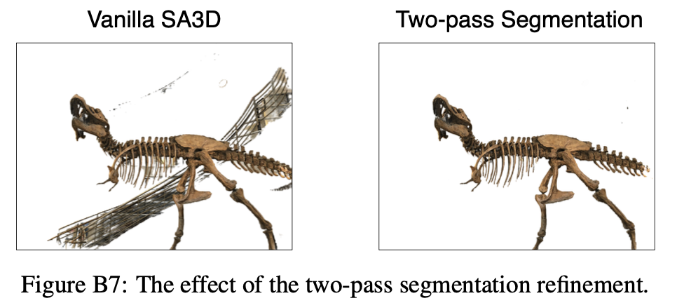
IoU-aware view rejection
Notes:
Not included in the experiments

Slide 10
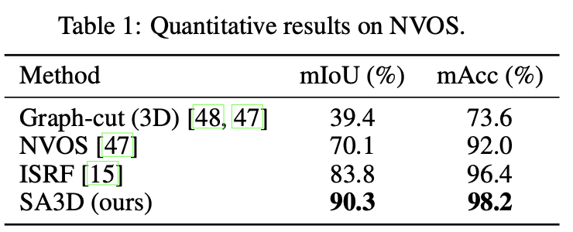
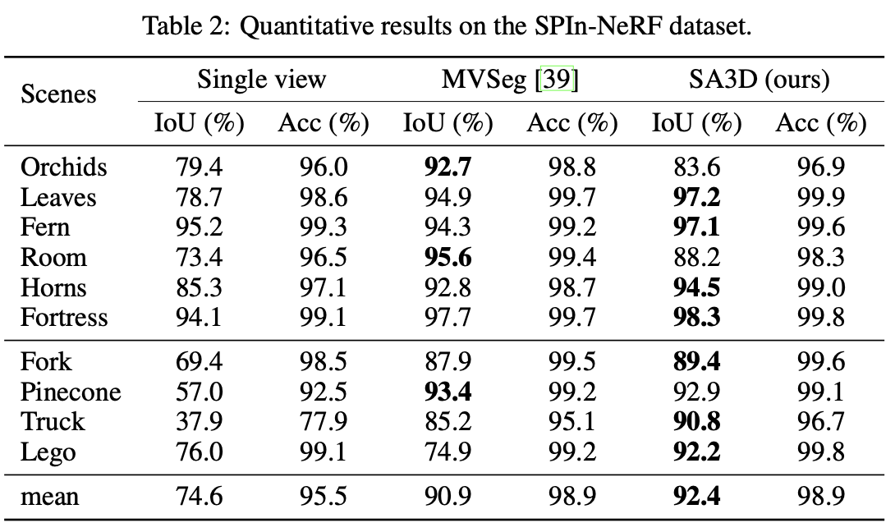
Results

Slide 14
Ablation Study

Slide 15
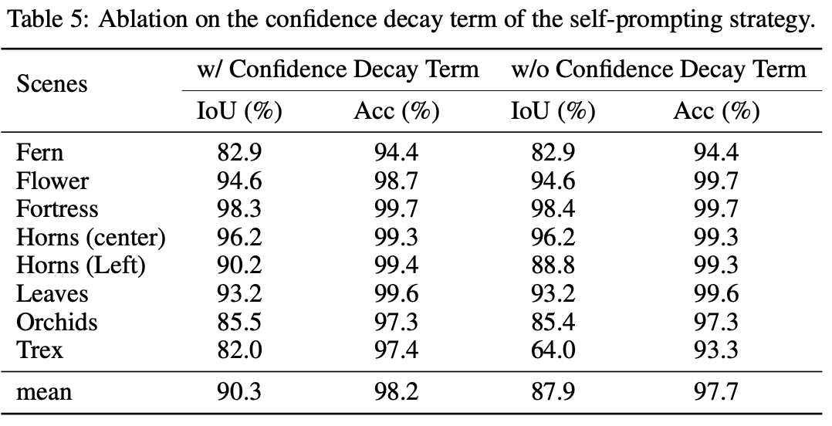
Ablation Study

Slide 16
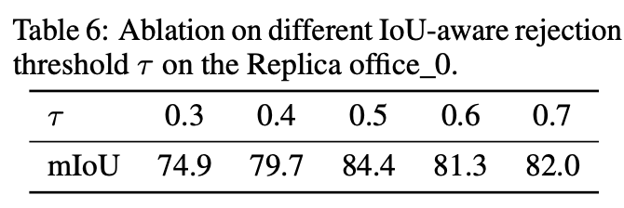
Ablation Study

Slide 19
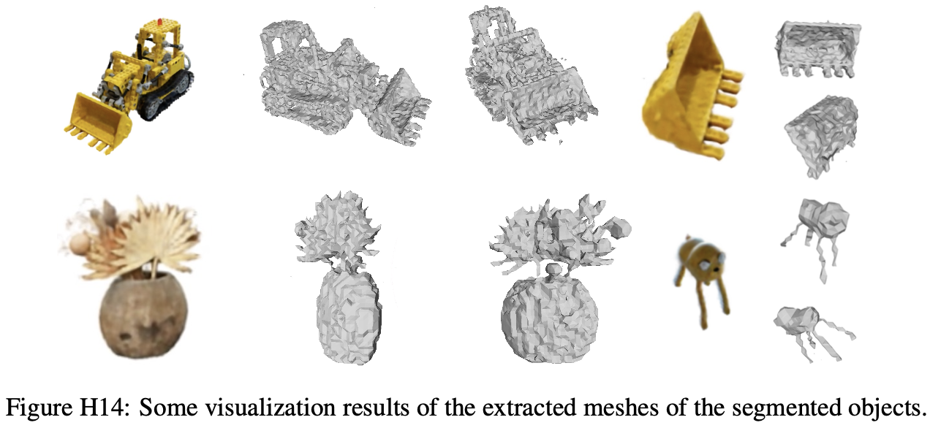

Slide 21
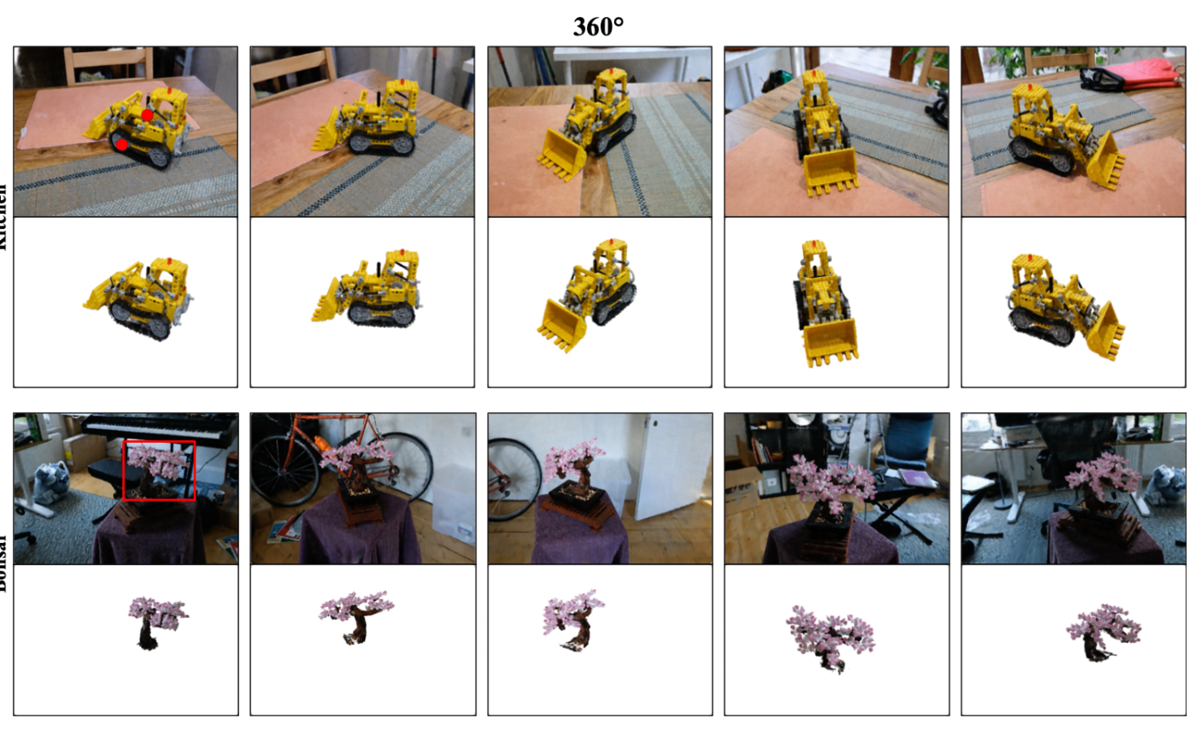

Slide 22
Q&A

